Slide 1
Intercultural Competence In Practice

Slide 2
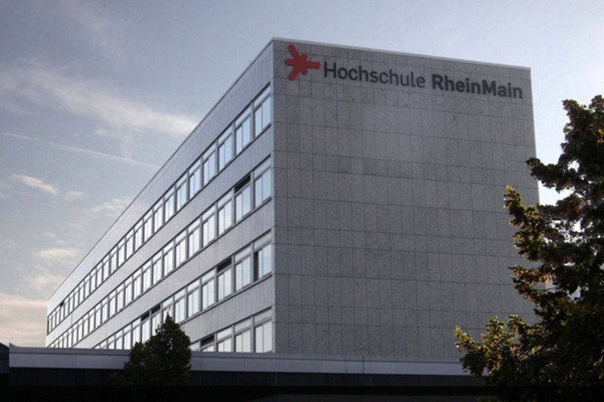
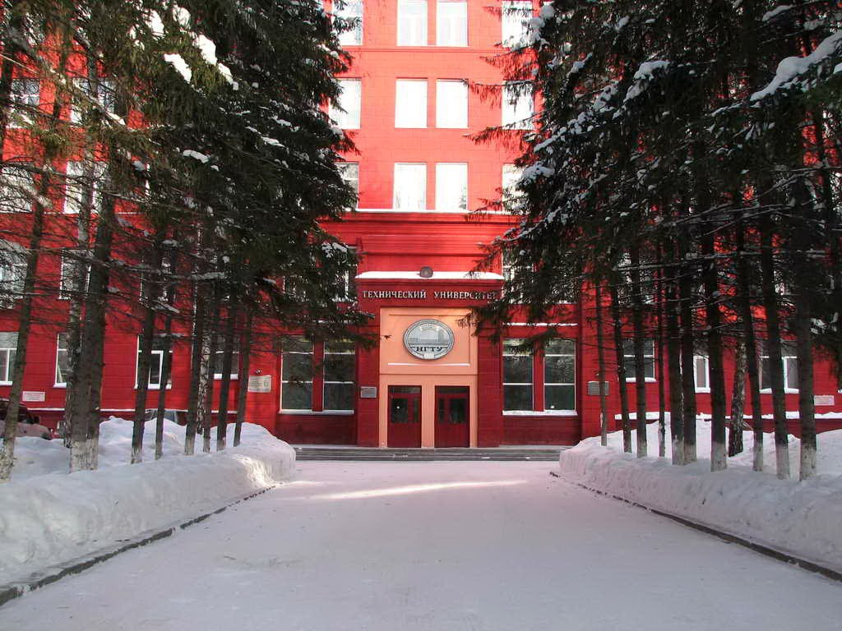
How to prepare an exchange program in Russia/Germany?

Slide 3
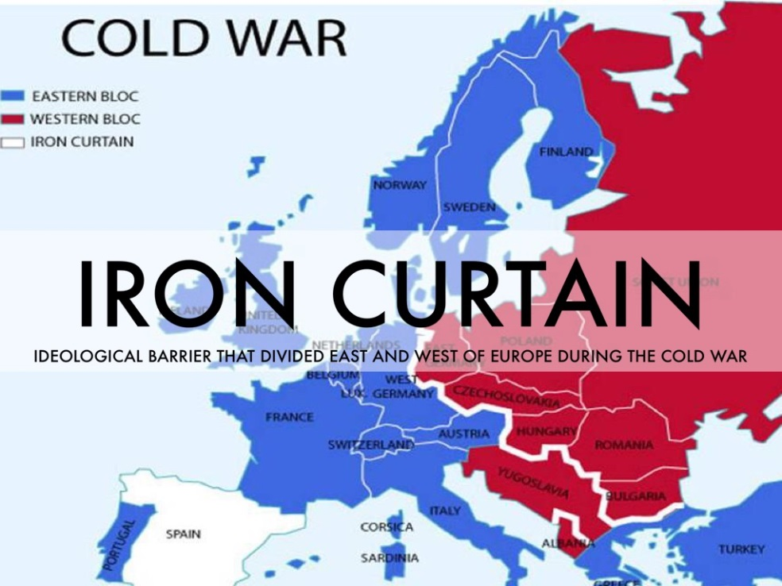
Is it possible to communicate in English language in the public? Are the signs in public/tourists places only mentioned in Russian or in English as well?

Slide 4
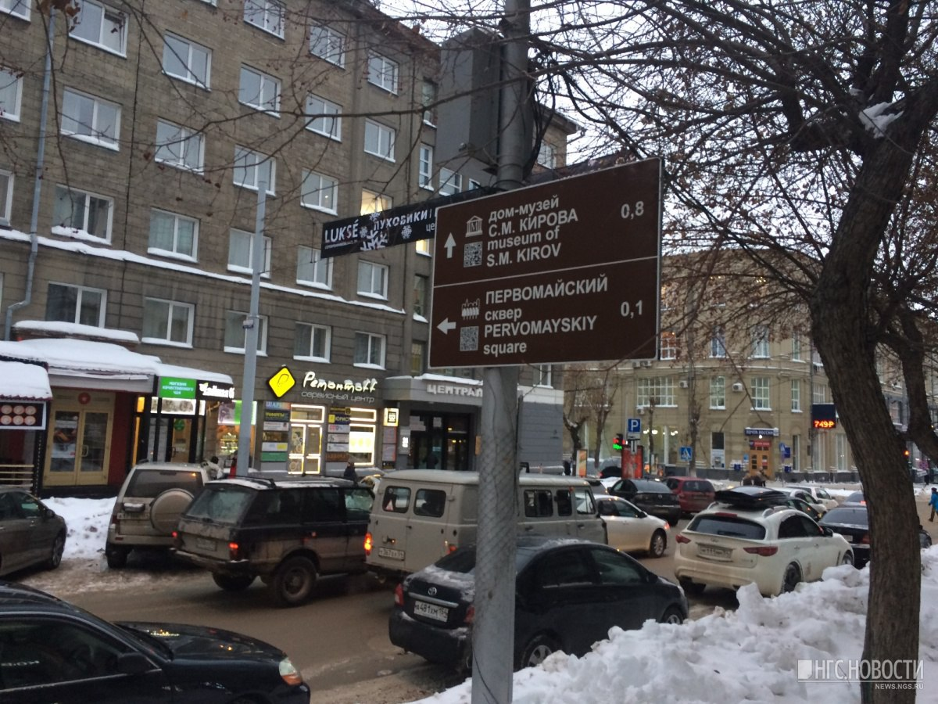
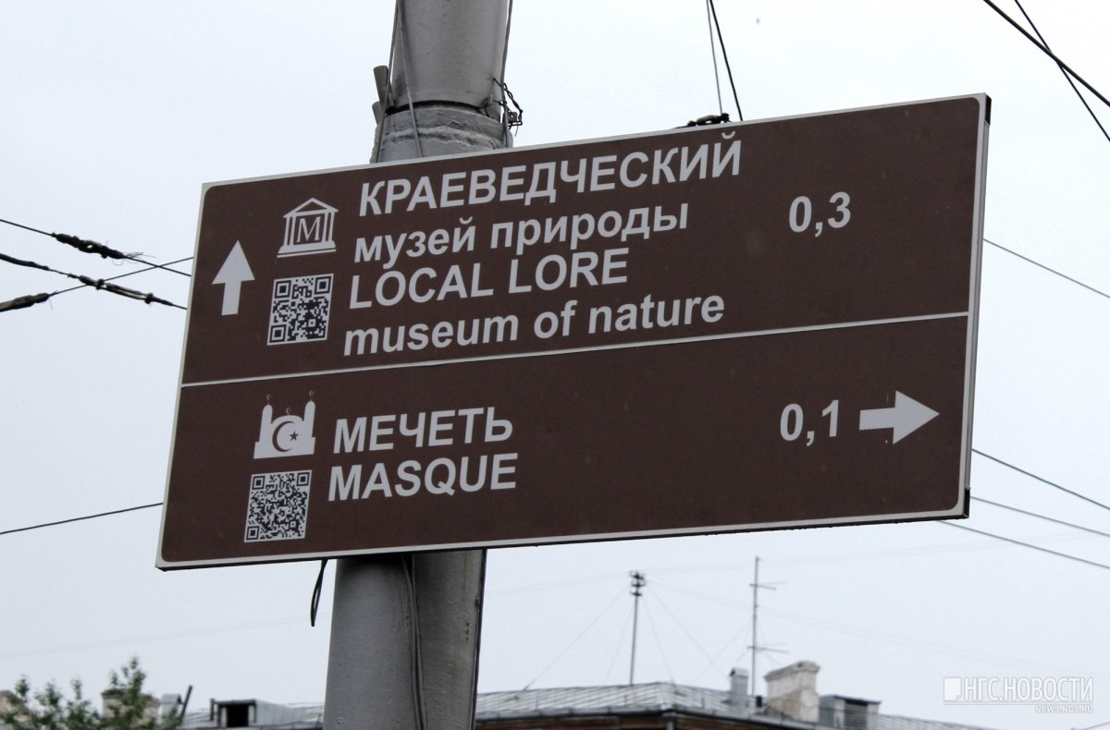
Is it possible to communicate in English language in the public? Are the signs in public/tourists places only mentioned in Russian or in English as well?

Slide 5
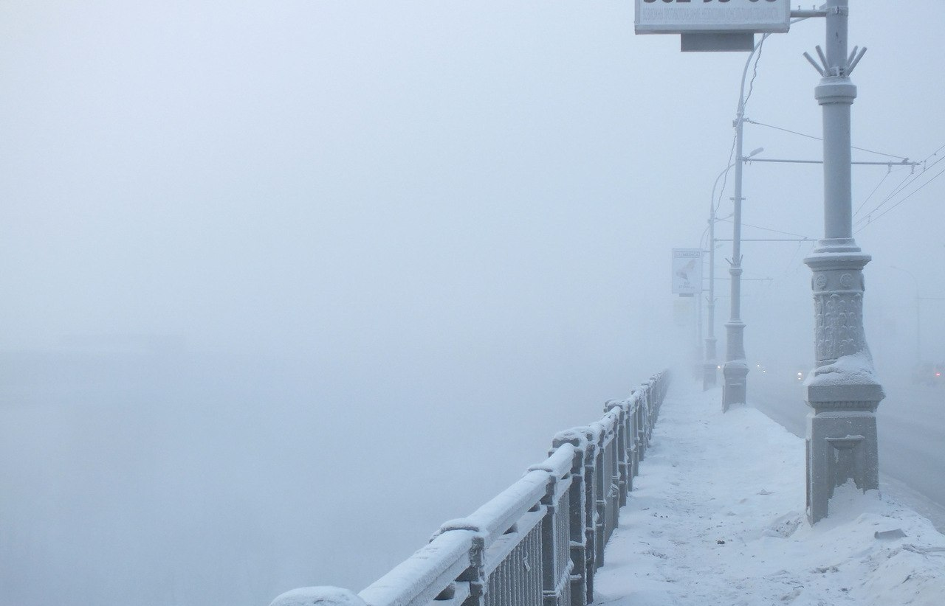
Is there something we have to be aware of?

Slide 6
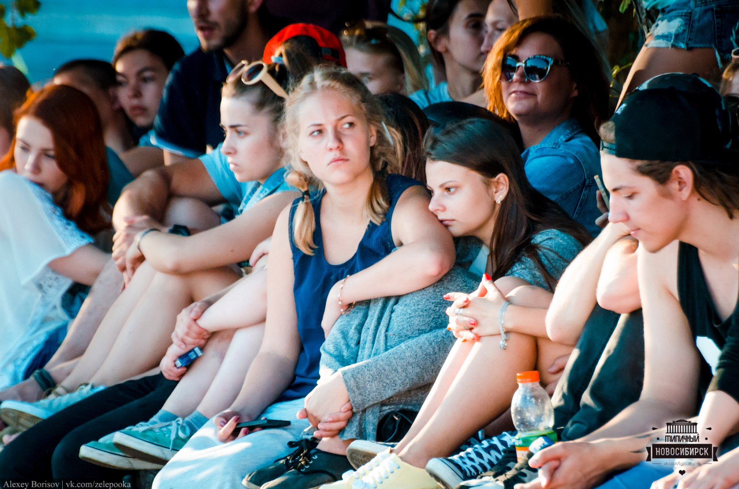
Is there something we have to be aware of?

Slide 7
Is there something we have to be aware of?

Slide 8
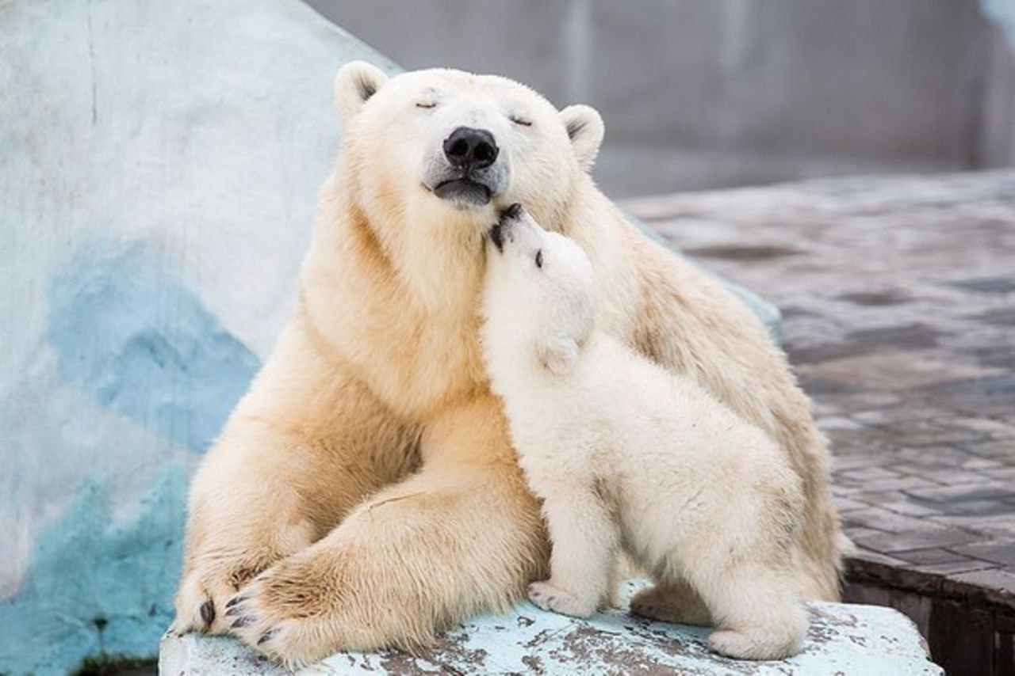
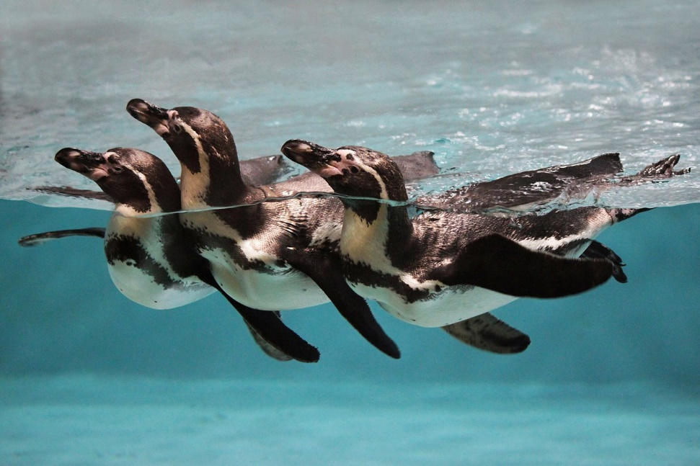
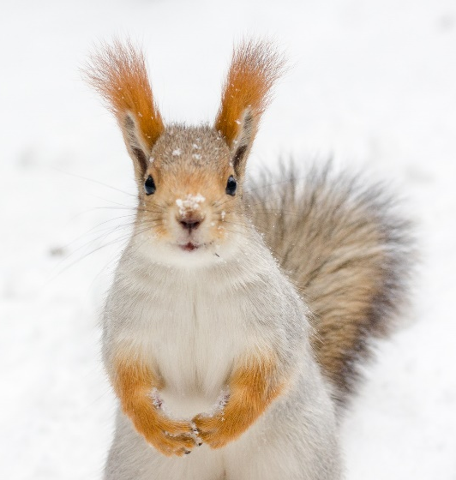
Is there something we absolutely need to see or visit before we leave Russia?

Slide 9
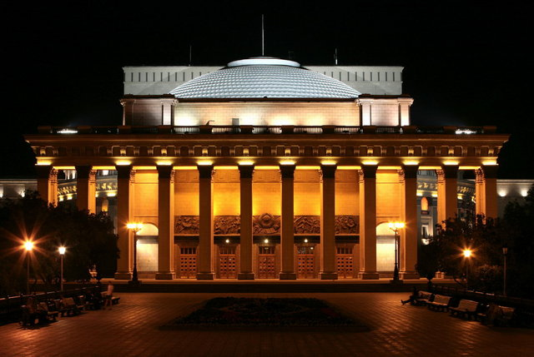
Is there something we absolutely need to see or visit before we leave Russia?

Slide 10
Is there something we absolutely need to see or visit before we leave Russia?

Slide 11
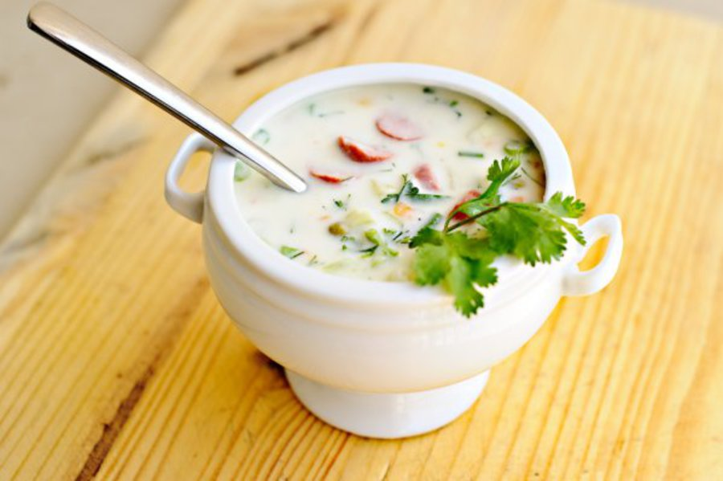
Can you tell of a Russian dish, what might be not suitable for a German person?
kisel
okroshka
holodets

Slide 12
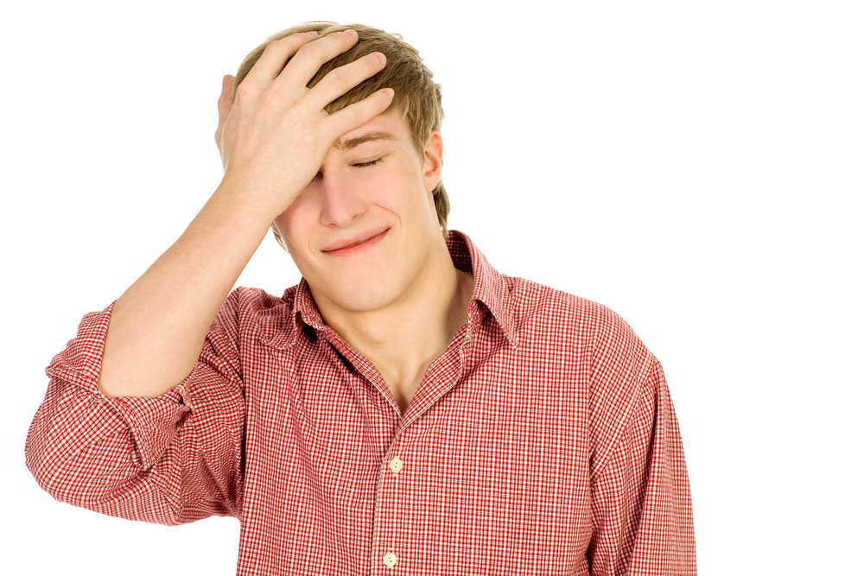
What would be embarrassing for a foreigner to do in Russia?

Slide 13
What would be embarrassing for a foreigner to do in Russia?

Slide 14
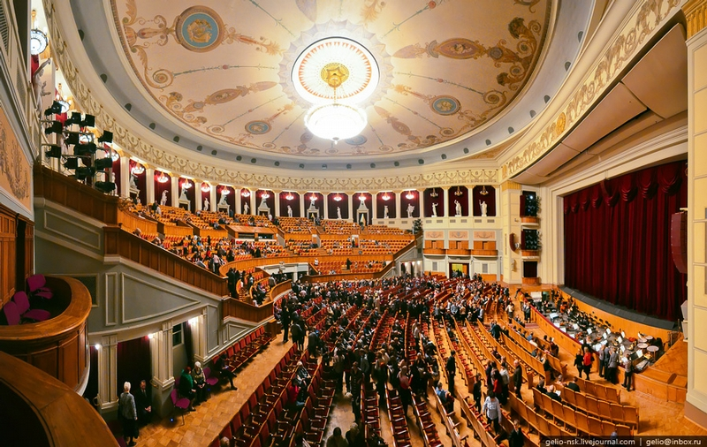
What would be embarrassing for a foreigner to do in Russia?

Slide 15
Thank you for your attention

