Slide 1
MEETING CULTURES
Elena Lebedeva
Olga Pozdnyakova
Katrin Schmidt
Maxim Tereschenko

Slide 2
Meeting cultures
First Things To Know
Where To Live & How to Get Around the City
Student Life
Christmas Edition

Slide 3
FIRST THINGS TO KNOW

Slide 4
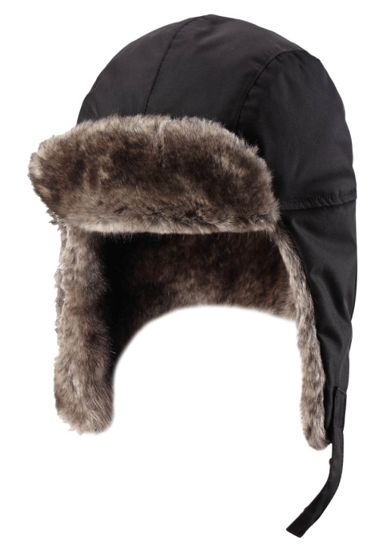
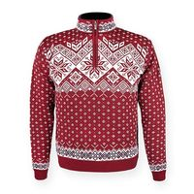
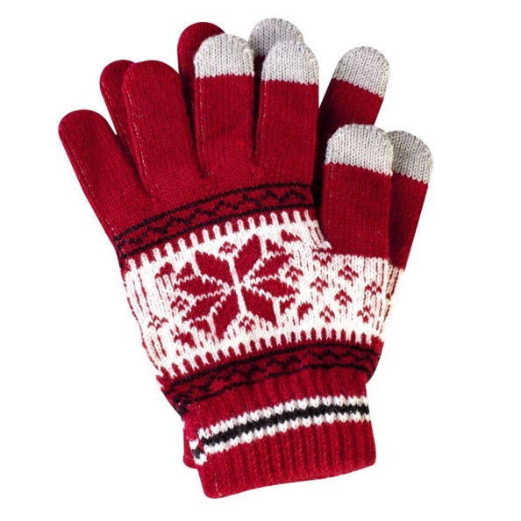
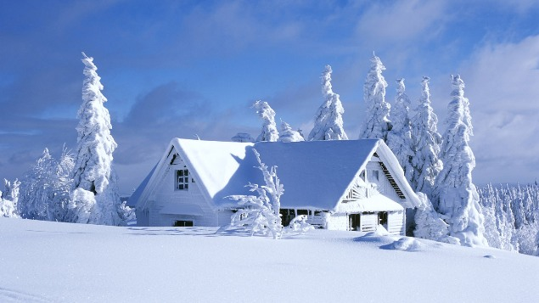
Siberian winter can be rough
Attention!
-30°C
very slippery
Don’t forget:
coat
gloves/mittens
warm clothes

Slide 5
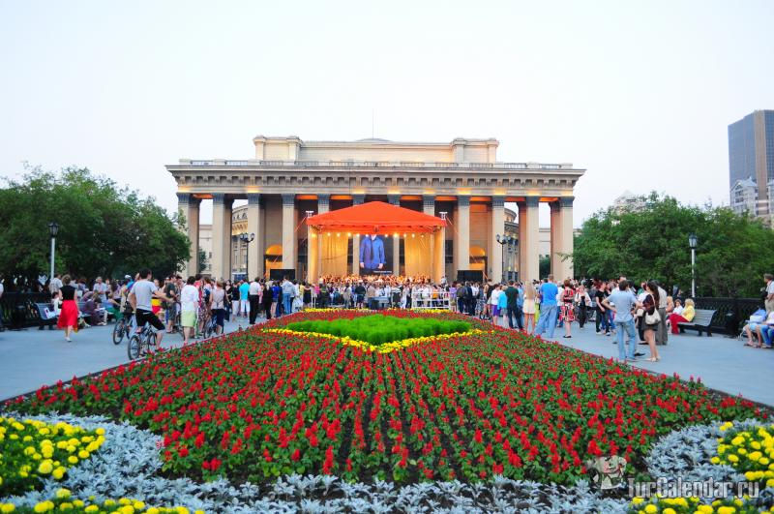
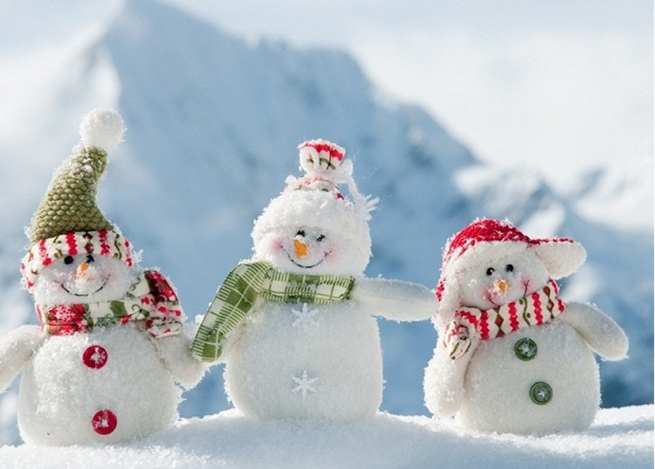
Student holidays
Summer: 2 months
Winter: 3 weeks

Slide 6
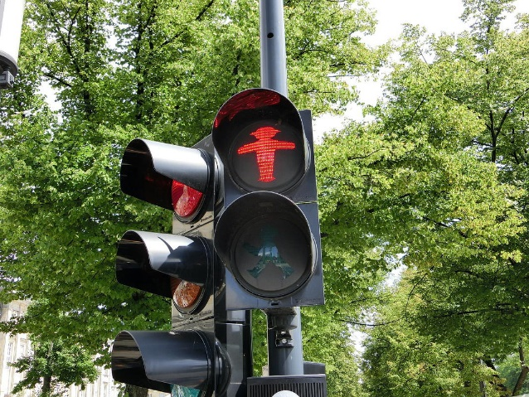
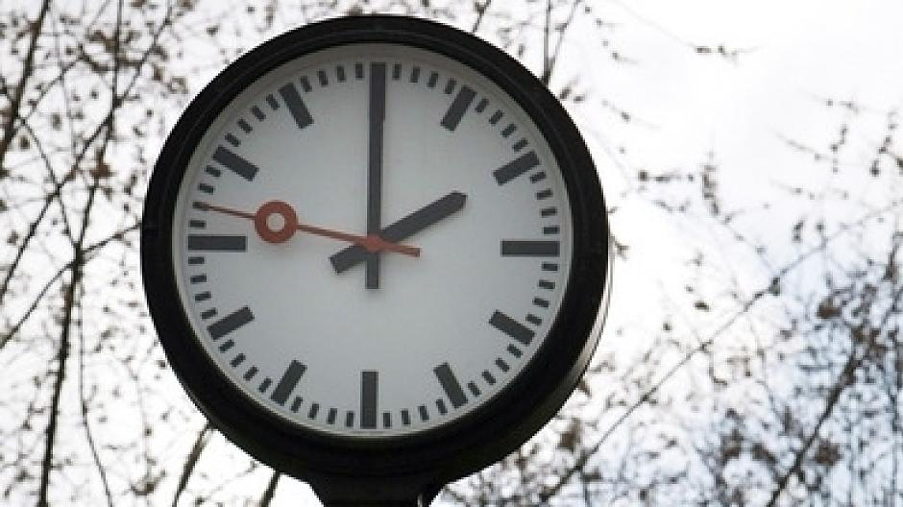
First things to know
Don’t walk over a red light …
Be on time (best to arrive 10 minutes early)

Slide 7
First things to know
Don’t walk over a red light…unless your late for the bus
Be on time (best to arrive 10 minutes early)

Slide 8
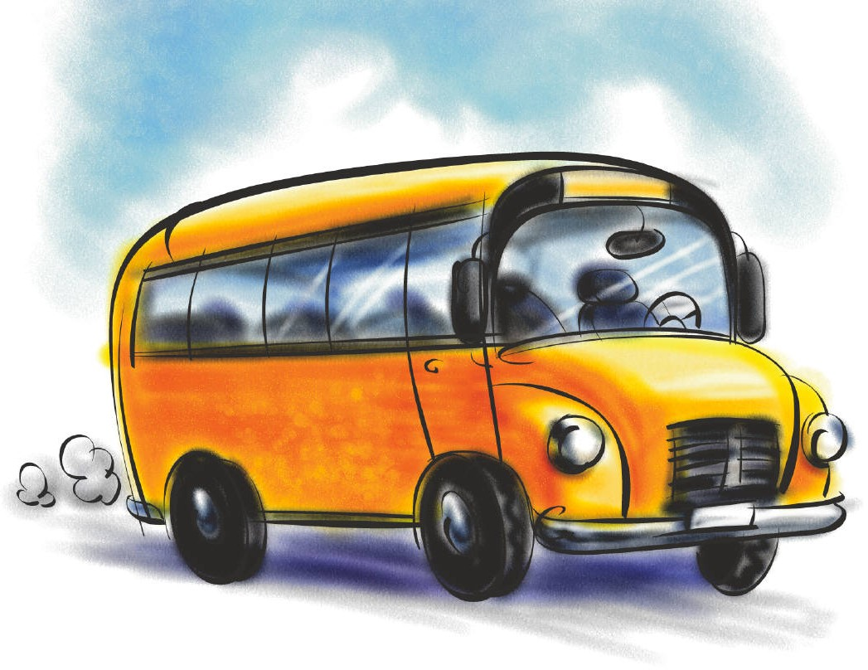
WHERE TO LIVE & HOW TO GET AROUND THE CITY

Slide 9
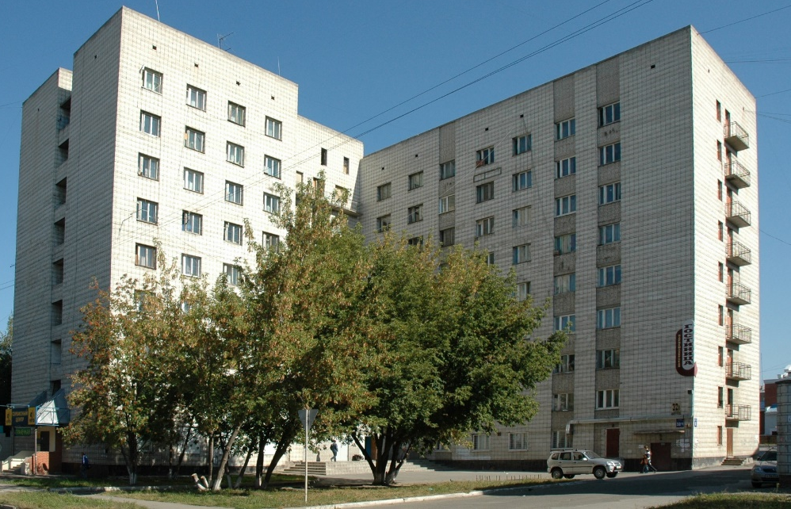
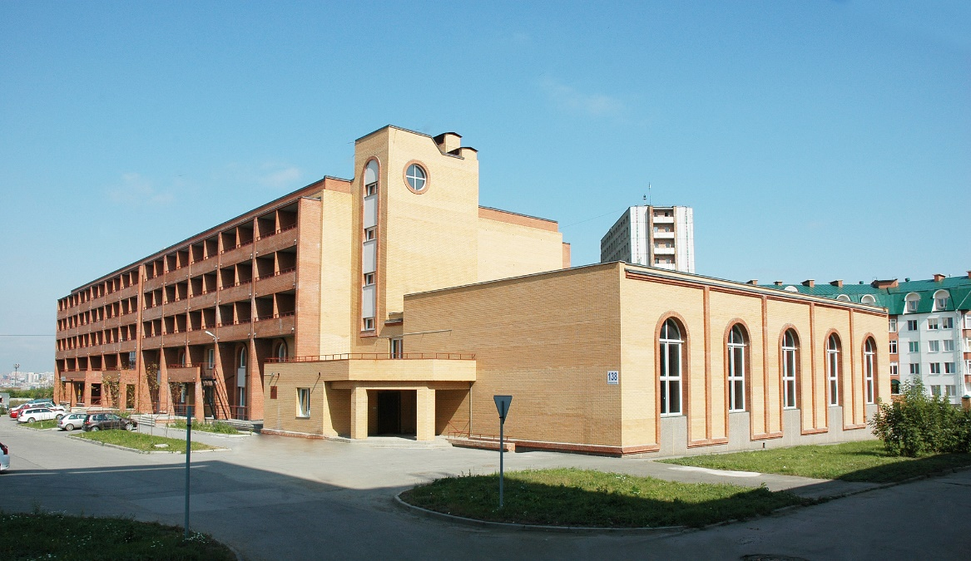
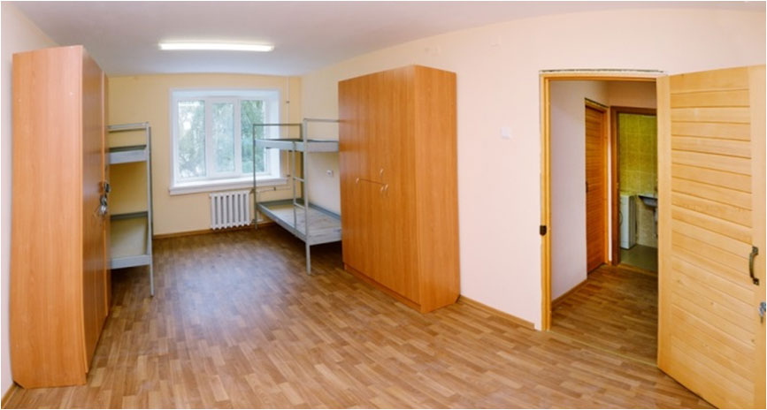
University hostel or dormitory
Conditions:
2- or 3-person rooms,
bathroom in the room or common bathroom on the floor,
common kitchen & laundry on each floor

Slide 10
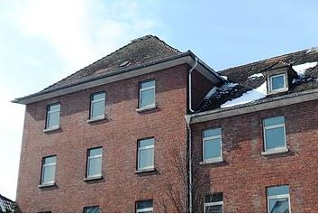
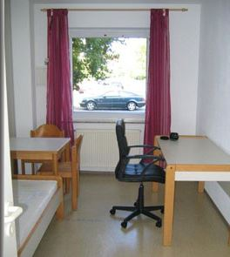
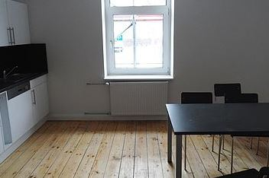
Dormitories
More student life and parties in Frankfurt, Mainz, Wiesbaden
more expensive rent, longer commute
Own room or living community
Con: Kitchens can be dirty but still okay
Pro: Easier to meet people

Slide 11
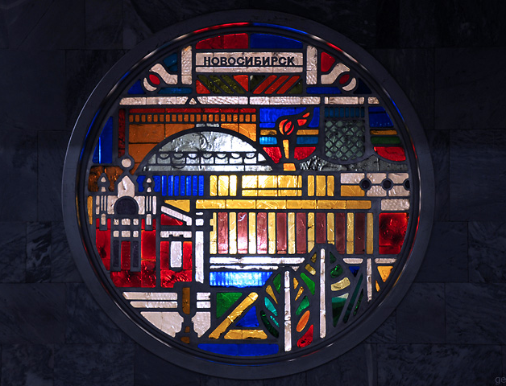
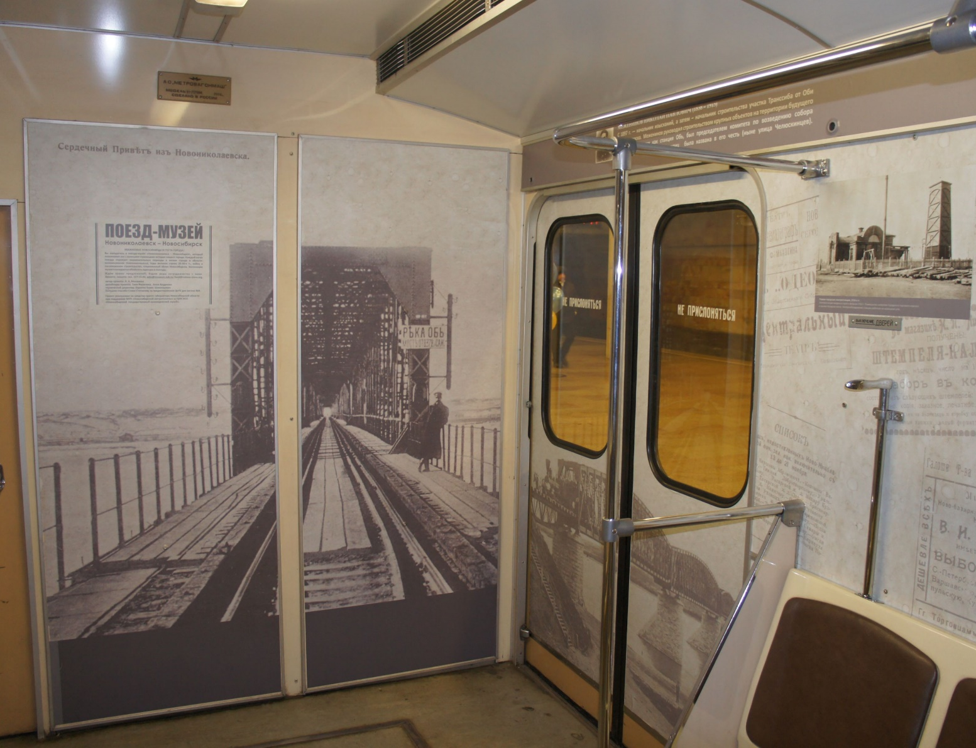
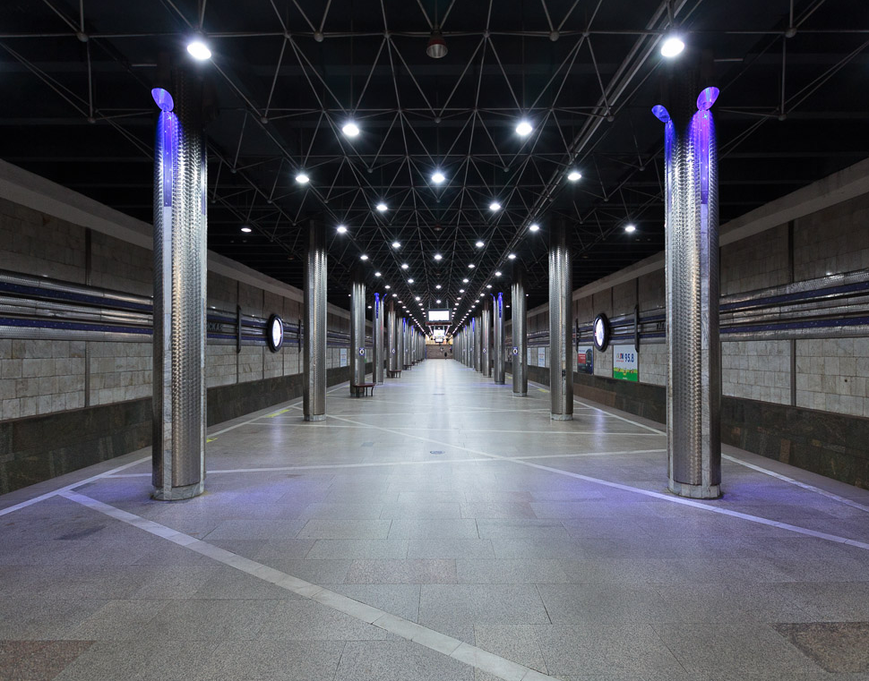
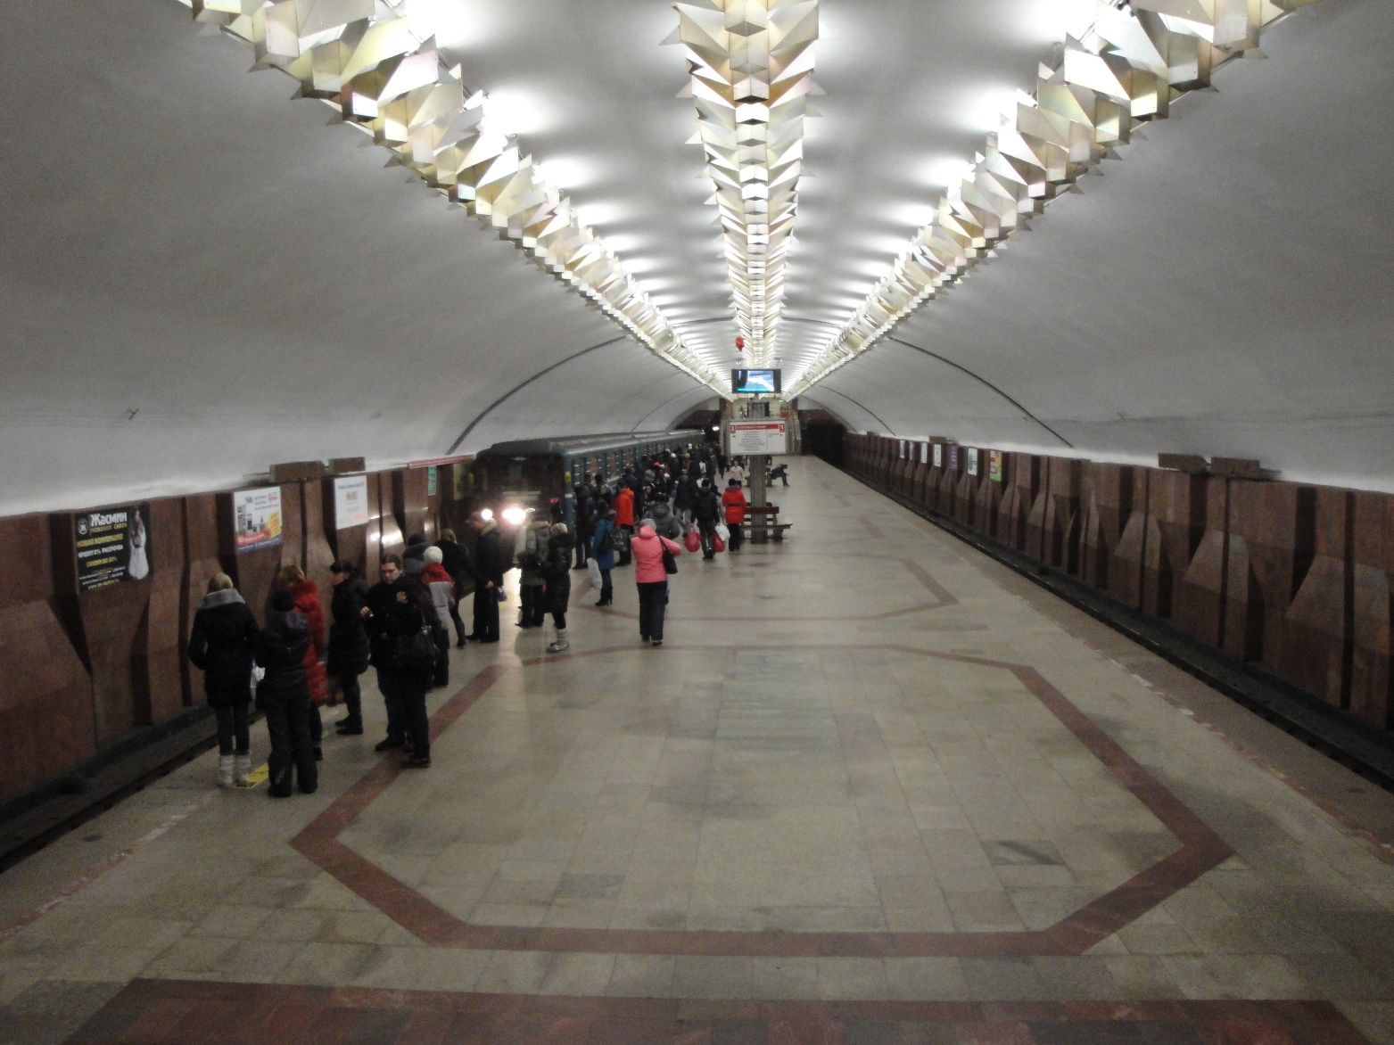
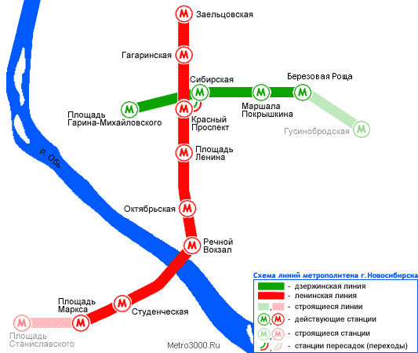
Subway
Pros:
fast
clean & beautiful
theme trains
Cons:
only 11 stations

Slide 12
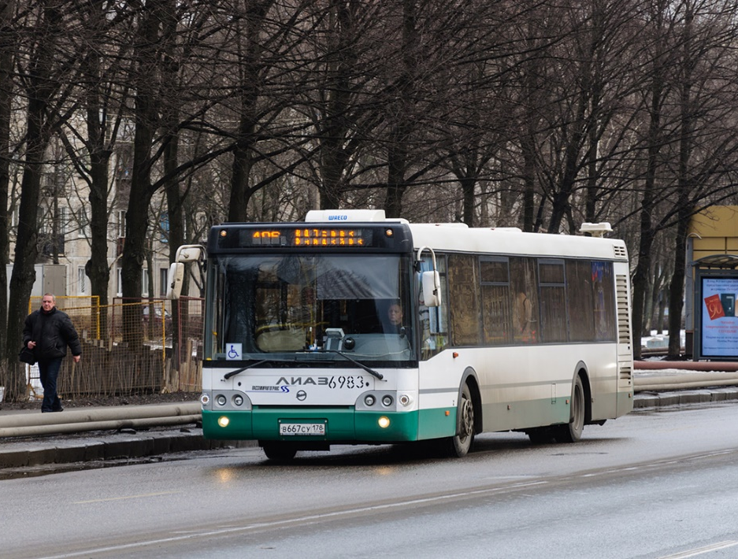
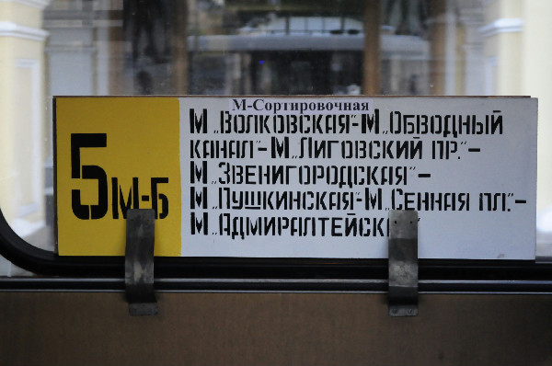
Buses, trolley buses, tramways & share taxis
Attention!
no schedule
there is a route written on each bus, but many bus station names are not mentioned there
What to do?
download 2GIS app
feel free to communicate

Slide 13
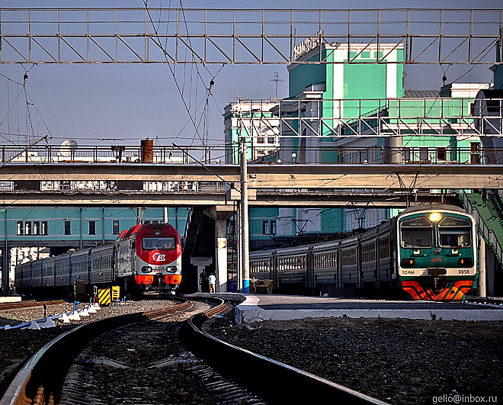
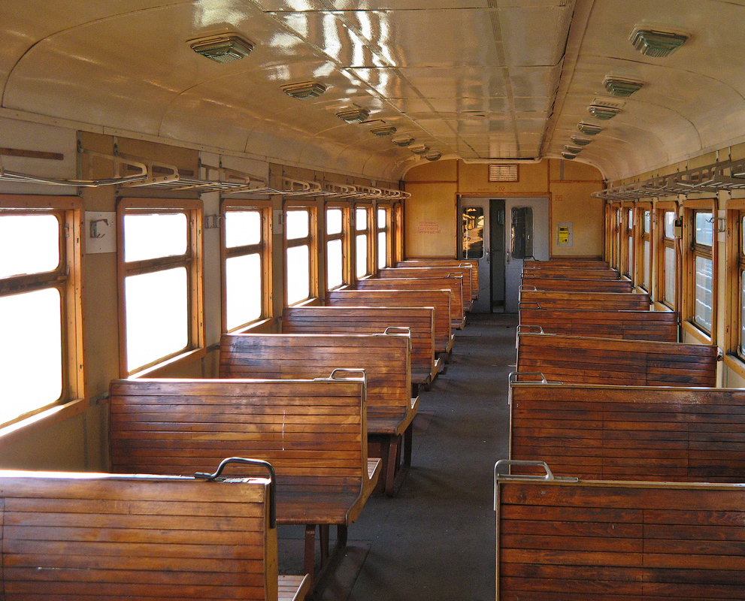
Trains
Good news! They always come on time

Slide 14
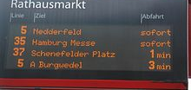
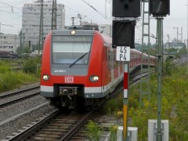
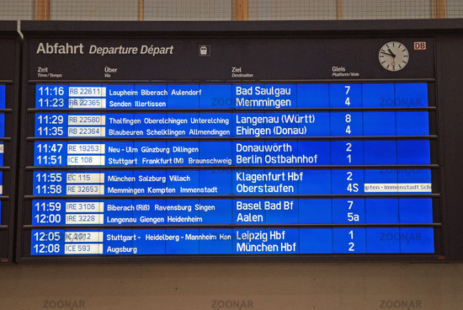
Trains, Buses & other transportation
Attention!
Trains are usually 5-10 min late
Ticket control
stops are usually announced/displayed
What to do?
Take a train 15-30 min earlier in rush hour
download DB Navigator app but look closely at the connection
DB app discloses all stops

Slide 15
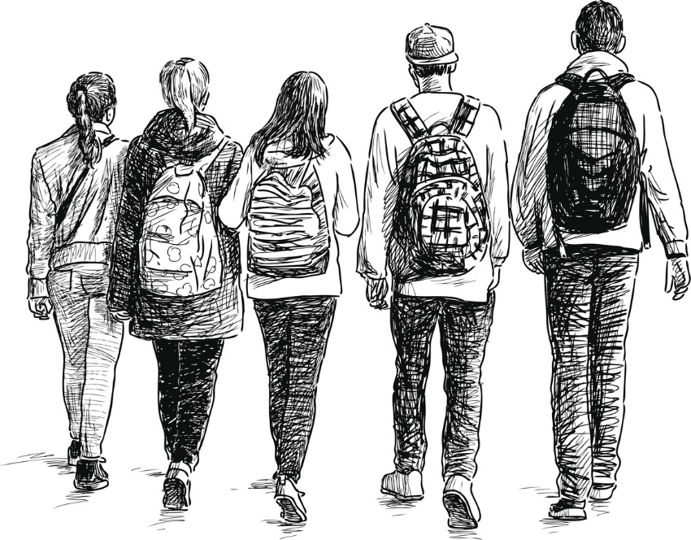
STUDENT LIFE

Slide 16
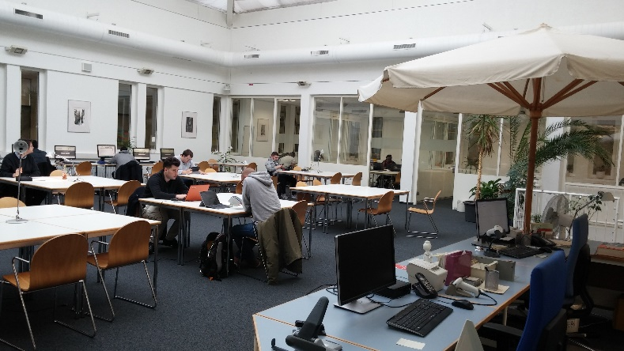
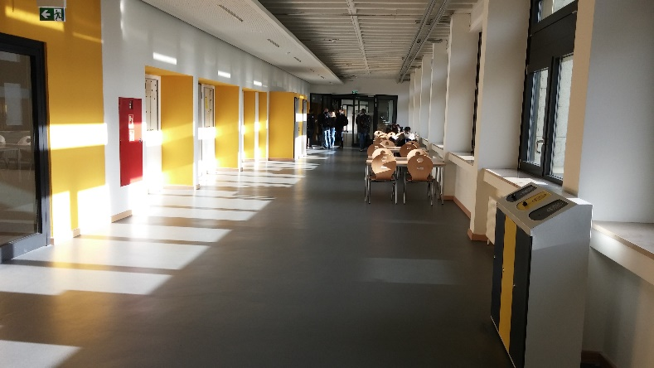
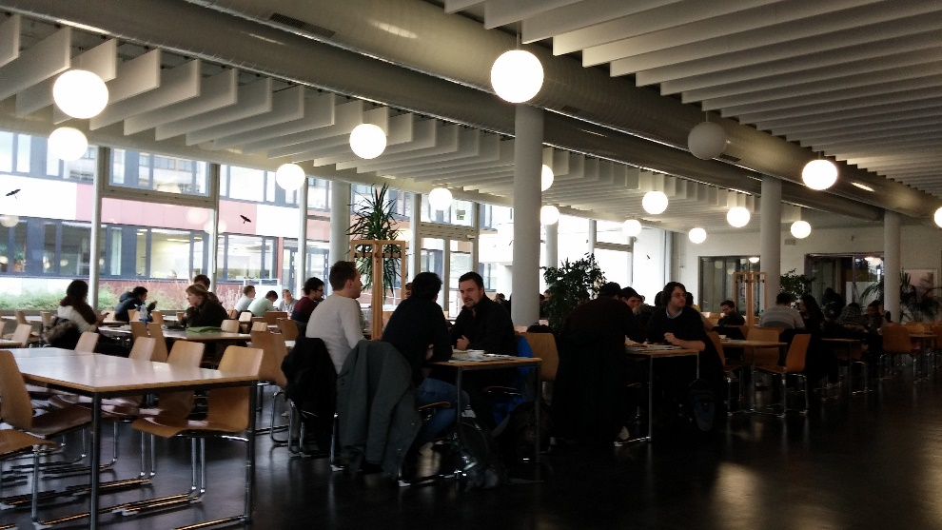
Everyday life
Go to the cafeteria
Study in the halls/library

Slide 17
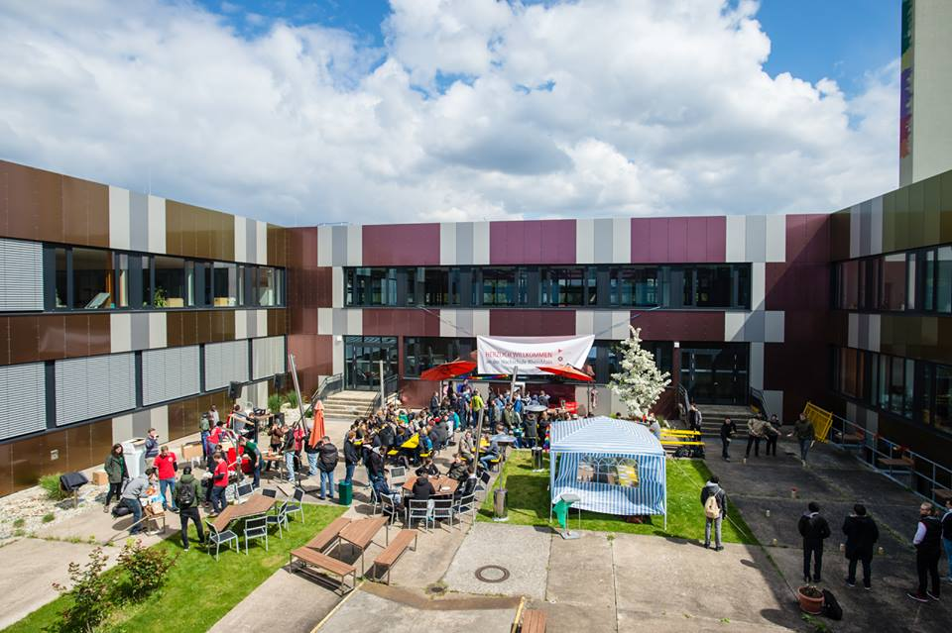
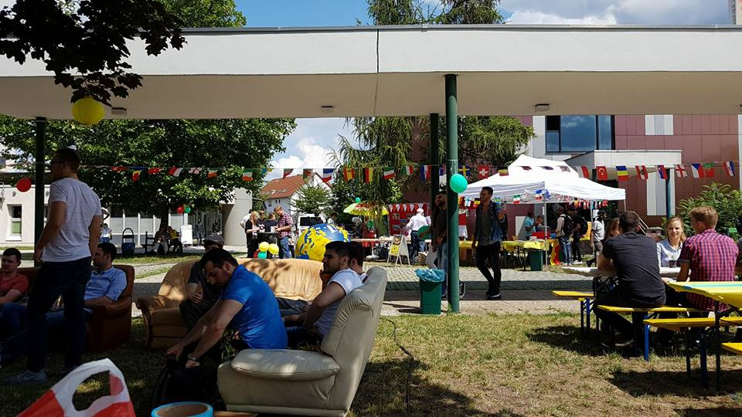
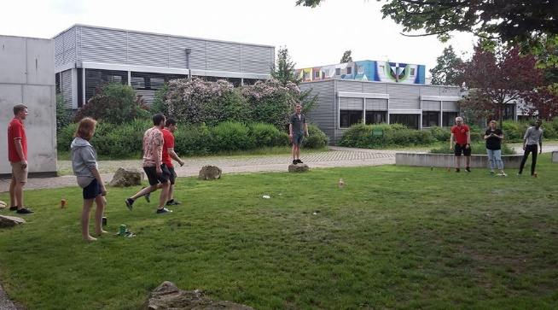
Events
Student body organizes movie nights, parties, poker tournaments
Don’t miss
First semester barbecue
My Prof is my DJ

Slide 18
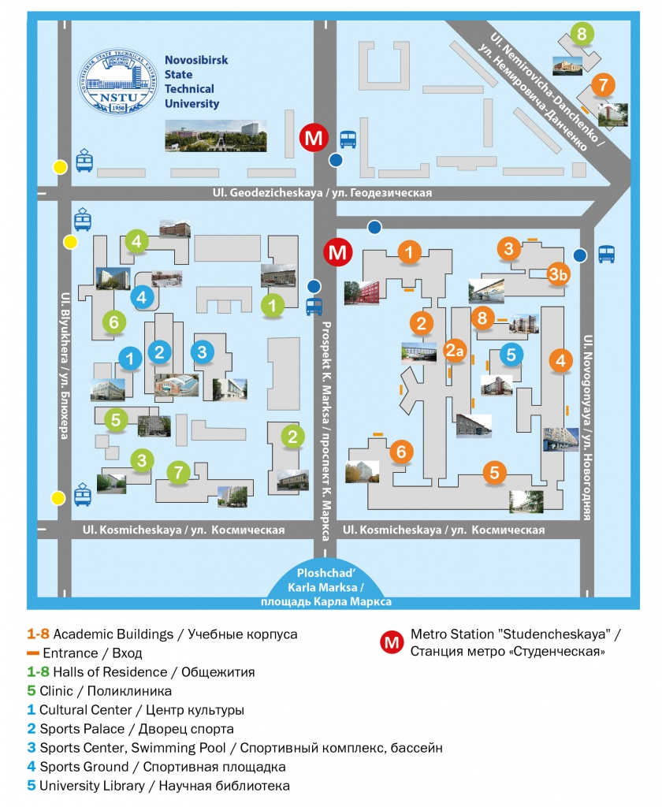
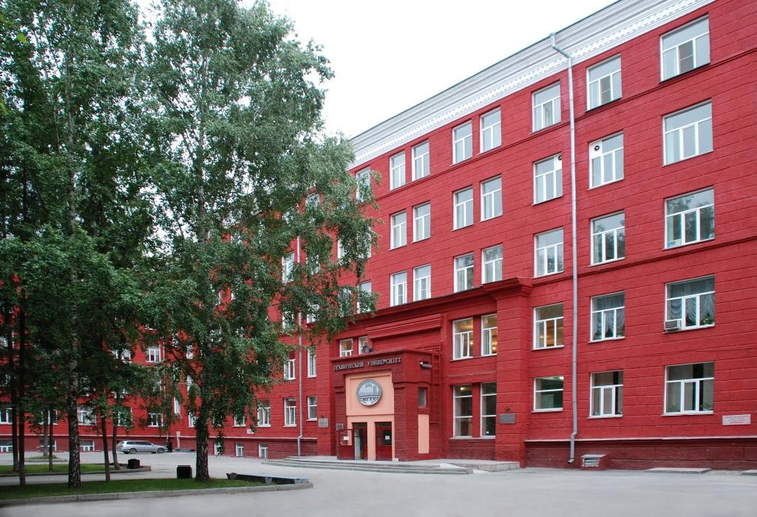
NSTU campus life

Slide 19
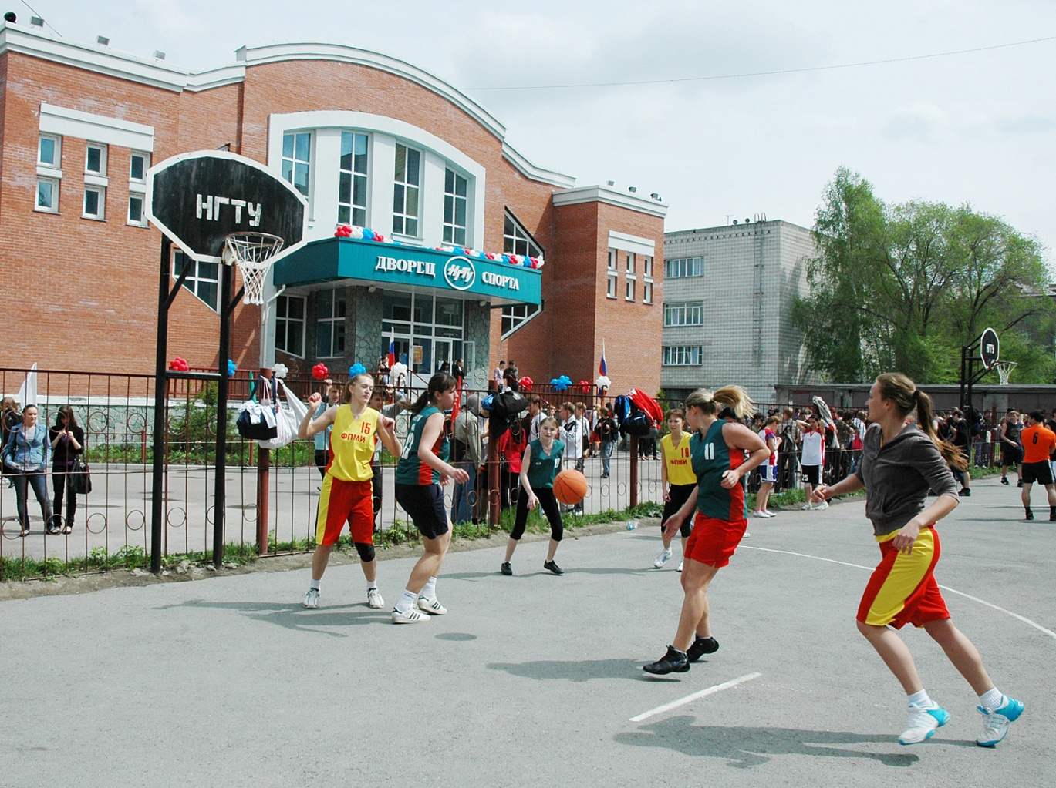
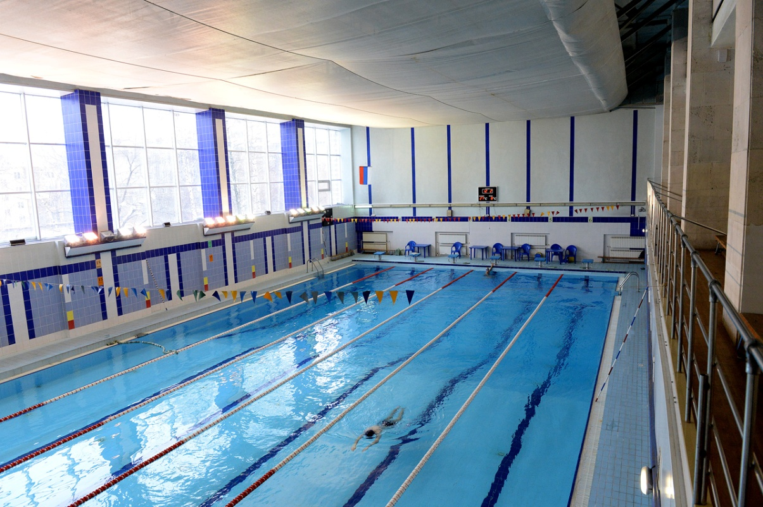
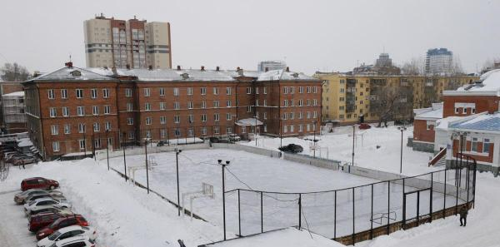
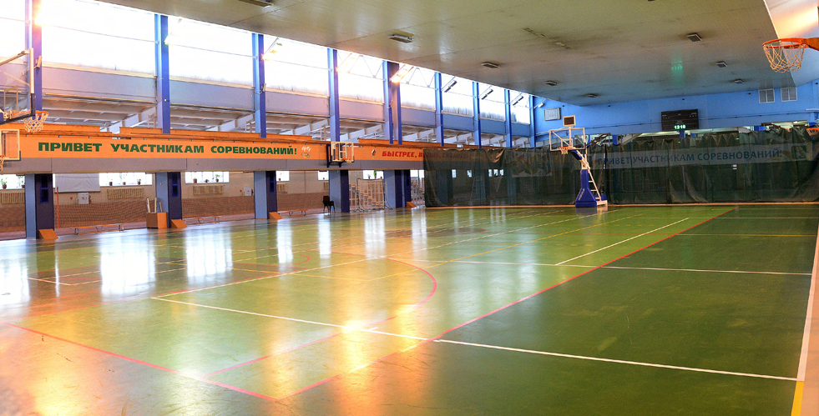
NSTU Sport

Slide 20
Enjoy your free time
University provides:
КВН («Club of the Funny and Inventive People»)
film club «КиНЭТИка!»
art space «Твоя сцена»
jazz band
ballet studio
and much more!
Keep up with latest events with NSTU VK community.

Slide 21
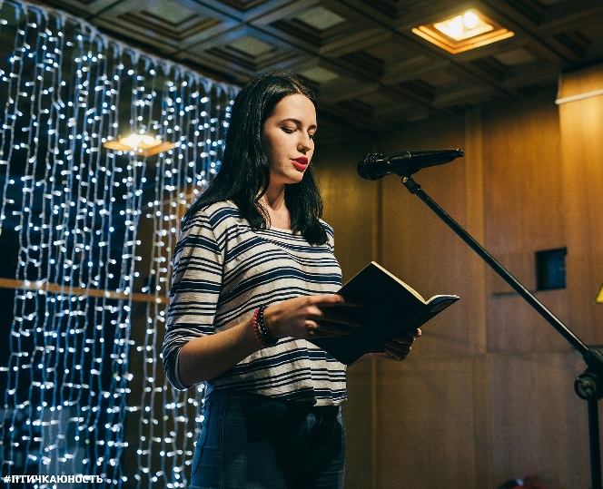
Enjoy your free time
Novosibirsk provides:
Youth centers «Этаж» (“Storey”), «Крыша» (“Roof”), «Юность» (“Youth”) and «Содружество» (“Community”) organize tons of events, such as:
concerts
movies
interesting lectures
parties
contests,
and others.

Slide 22
Christmas Edition

Slide 23
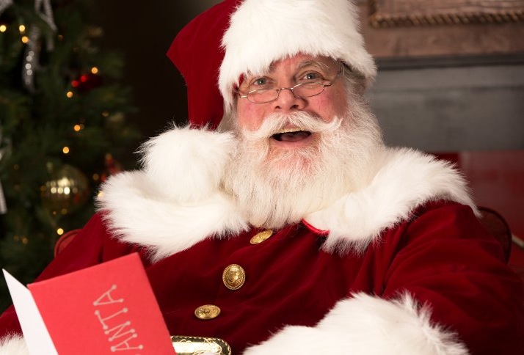
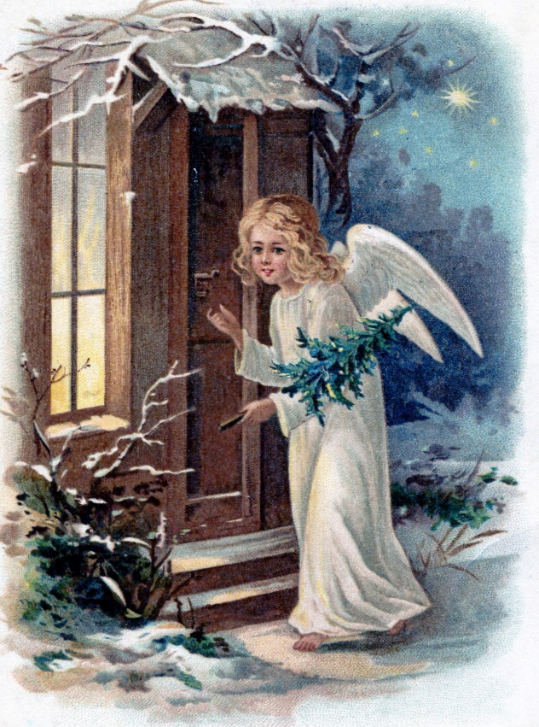
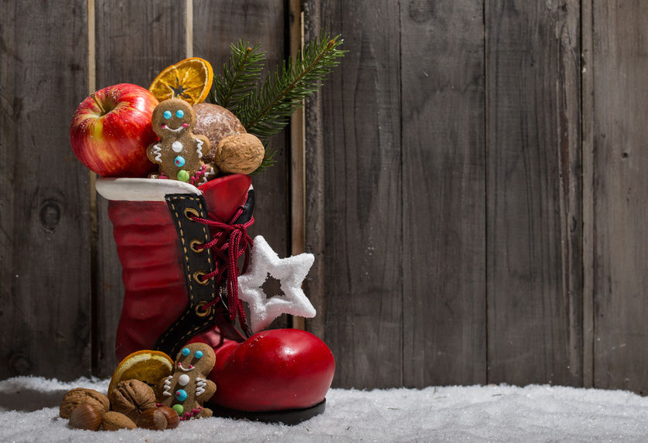
Festivities
Nikolaus-Day (6th December)
Christmas (24th December)
New Years Eve (31st December)

Slide 24
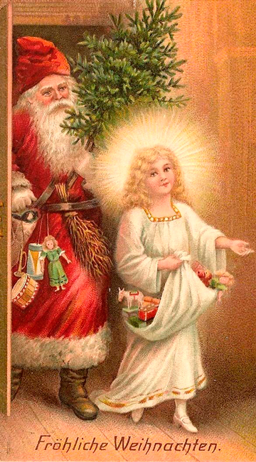
Christkind or Santa Clause?
both co-exist/are celebrated
Different figures and helpers in different regions

Slide 25
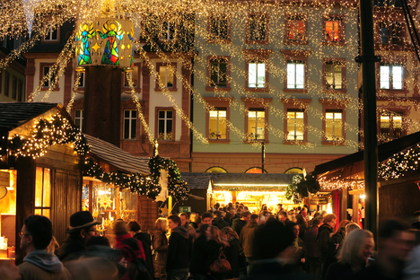
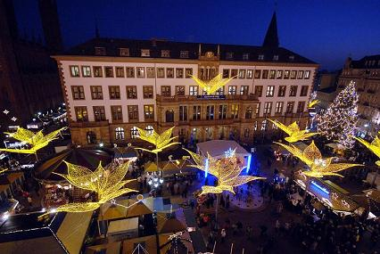
Christmas Markets
Every small town and city
Handmade crafts, decorations, food

Slide 26
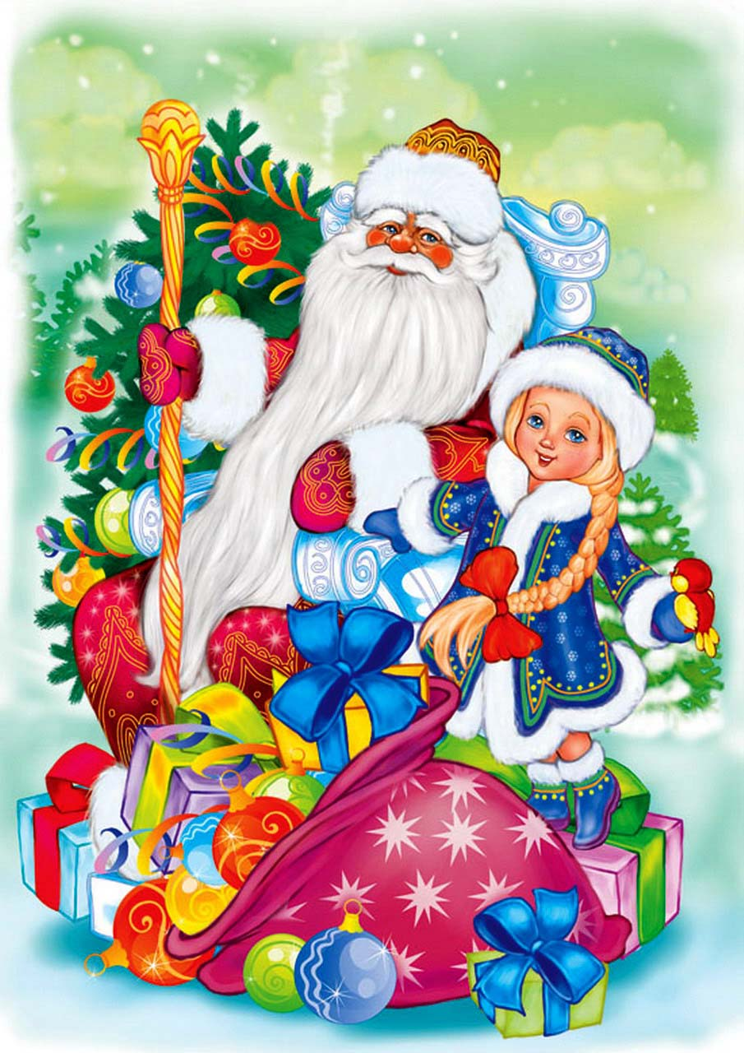
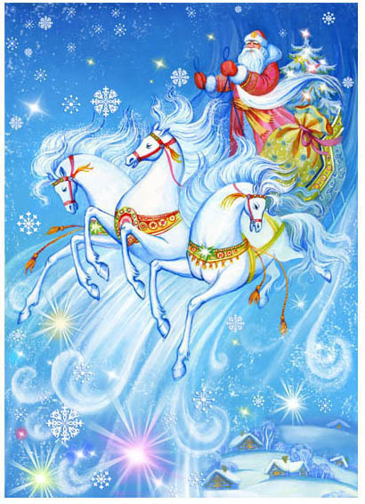
Ded Moroz
Assistant: his granddaughter Snegurochka
Transport: trio of hourses
Lives in Veliky Ustyug

Slide 27
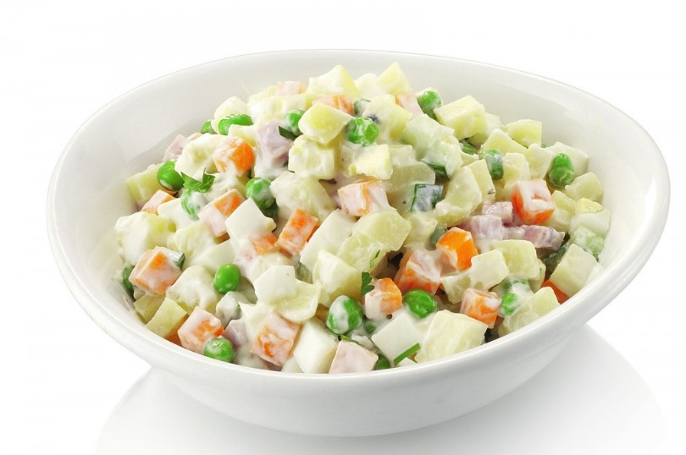
There’s no New Year without…

Slide 28
More festivities!
Christmas
January, 7
Old New Year January, 13-14

Slide 29
Thank You for Attention!

Slide 31
References
Illustrations:
https://hhpblog.s3.amazonaws.com/blog/wordpress/wp-content/uploads/2016/12/iStock-513534403.jpg
http://dnepr.info/wp-content/uploads/2015/06/marshrutochka.jpg
http://nsk.sibnovosti.ru/culture/131570-v-novosibirskom-metro-nachal-kursirovat-poezd-muzey
http://www.nsk-metro.ru/img/Stations/Rechnoi%20Vokzal/03.jpg
http://www.metrowalks.com/ru/novosibirsk/leninskaya/gagarinskaya
https://kudago.com/nsk/place/stanciya-ploshad-marksa-novosibirsk/
http://metro3000.ru/06-novosibirsk-metro.html
http://busphoto.ru/photo/01/03/92/103921.jpg
http://spb-gid.ru/transport/wheeled-transport/nochnye-avtobusy-spb/
https://trainpix.org/photo/74667/
http://bk54.ru/news/article/5885/
http://www.misucell.com/WDF-251240.html
https://i.pinimg.com/736x/ed/98/89/ed98892c005049b13e2ae9af2e99d865--snow.jpg
http://cdn.fishki.net/upload/post/201511/30/1758000/7e666160afb6e96bb1a7bbe57fa1719c.jpg
http://www.tapeta-prezent-sylwester-szampan.na-pulpit.com/zdjecia/prezent-sylwester-szampan.jpeg
https://st.zakupka.tv/images/c09bc66a-62be-3105-a8da-3aa2ca1ceb43.jpg
http://1sg.ru/content/photo_albums/b36e4c879f2bd18ad93de0010590be55.jpg
https://pbs.twimg.com/media/DP5HJbxXUAIs7pw.jpg
https://i.mycdn.me/image?id=862069068656&t=35&plc=WEB&tkn=*xlAFWnb8_AhuJRLf49s9v9zejnA
http://img1.liveinternet.ru/images/attach/c/8/125/354/125354117_5320672_8406426.gif
http://russianconstruction.com/uploads/posts/2016-05/1462447383_26138.jpg
http://www.sovsibir.ru/news/162346
http://cdidriksen.femelle.no/wp/wp-content/uploads/2012/08/6860563113_9b774d64bb_b.jpg
https://media.licdn.com/mpr/mpr/AAEAAQAAAAAAAA1nAAAAJGM4OTAwM2Y3LThhMmQtNGZmZi1hNzQxLWQzMjllNTNjOGFkOA.jpg
https://vk.com/onfloornsk
https://vk.com/junost_dm
https://vk.com/sodrughestvo54

Slide 32
References
Illustrations:
https://upload.wikimedia.org/wikipedia/commons/thumb/e/e1/FlixBus_Setra_S_431_DT_-_Berlin_ZOB.jpg/1200px-FlixBus_Setra_S_431_DT_-_Berlin_ZOB.jpg
http://cdn2.spiegel.de/images/image-1047949-galleryV9-fzpo-1047949.jpg
https://www.google.de/url?sa=i&rct=j&q=&esrc=s&source=images&cd=&ved=0ahUKEwjg6sfyt__XAhXFVhQKHQulDk0QjBwIBA&url=https%3A%2F%2Fupload.wikimedia.org%2Fwikipedia%2Fcommons%2Fthumb%2Fa%2Fac%2FFIMS-Anzeige.jpg%2F220px-FIMS-Anzeige.jpg&psig=AOvVaw1Fl8ItSBgJo0A6p47AkW2G&ust=1512994987450494
http://gifts.steisy.com/collection/suveniry-po-individualnomu-dizaynu/product/zimnie-vyazanye-perchatki-dlya-sensornyh-ekranov
http://softcraze.com/zima-blizka-bg-14244/
https://www.google.ru/url?sa=i&rct=j&q=&esrc=s&source=images&cd=&cad=rja&uact=8&ved=0ahUKEwjY9_j1gILYAhUnApoKHdPsABwQjxwIAw&url=http%3A%2F%2Fwww.reimashop.ru%2Fcatalog%2Faksessuar%2Fgolovnye-ubory%2Fshapka-ushanka%2F&psig=AOvVaw3CXFRRZ3JJgNHRGLFGsSxT&ust=1513083361535880
https://www.google.ru/url?sa=i&rct=j&q=&esrc=s&source=images&cd=&cad=rja&uact=8&ved=0ahUKEwizuNjCgYLYAhWFFZoKHRG2BIwQjxwIAw&url=https%3A%2F%2Flimon.md%2Fru%2Fclothes-and-accessories%2Fwarm-clothes&psig=AOvVaw24mw2YyCxd2ZgfALamzP2G&ust=1513083455715966
https://www.google.ru/url?sa=i&rct=j&q=&esrc=s&source=images&cd=&cad=rja&uact=8&ved=0ahUKEwjHpNmBgoLYAhWhNpoKHdVeCtQQjxwIAw&url=https%3A%2F%2Fwww.youtube.com%2Fwatch%3Fv%3DmZkpZFyjsms&psig=AOvVaw1II88_rwtSWf3GvWo7Icaj&ust=1513083638486943
https://www.google.ru/url?sa=i&rct=j&q=&esrc=s&source=images&cd=&cad=rja&uact=8&ved=0ahUKEwijm-iBhILYAhWECJoKHVAFAIIQjxwIAw&url=http%3A%2F%2Fwww.turcalendar.ru%2Fnovosibirsk%2F&psig=AOvVaw2wegNS8d3fajGS2Xg5iife&ust=1513084179625832
https://www.google.ru/url?sa=i&rct=j&q=&esrc=s&source=images&cd=&cad=rja&uact=8&ved=0ahUKEwjyoZXWg4LYAhWmC5oKHU_iA6gQjxwIAw&url=https%3A%2F%2Feisk-licey4.ru%2Fsovsem-skoro-zimnie-kanikuly%2F&psig=AOvVaw1DEwmRxCfFugMjhE7JCLw6&ust=1513084088874991
https://www.google.ru/url?sa=i&rct=j&q=&esrc=s&source=images&cd=&cad=rja&uact=8&ved=0ahUKEwiy96aqioLYAhXFFZoKHeKYDyMQjRwIBw&url=http%3A%2F%2Fwww.nstu.ru%2Fsport%2Fsport_buildings&psig=AOvVaw1g_oeYvJDy2eJ4dptU8VUd&ust=1513085885484679
https://www.google.ru/url?sa=i&rct=j&q=&esrc=s&source=images&cd=&cad=rja&uact=8&ved=0ahUKEwiRn7nfioLYAhVsEpoKHa6_A3cQjRwIBw&url=https%3A%2F%2Fcommons.wikimedia.org%2Fwiki%2FFile%3ANstu-1.jpg&psig=AOvVaw0grsG1KUGtl40PqbucHQoW&ust=1513085981037723
https://www.google.ru/url?sa=i&rct=j&q=&esrc=s&source=images&cd=&cad=rja&uact=8&ved=0ahUKEwi2yeeci4LYAhVkApoKHUA8BxMQjRwIBw&url=http%3A%2F%2Fwww.nstu.ru%2Fsport%2Fsport_buildings&psig=AOvVaw0grsG1KUGtl40PqbucHQoW&ust=1513085981037723
https://www.google.ru/url?sa=i&rct=j&q=&esrc=s&source=images&cd=&cad=rja&uact=8&ved=0ahUKEwjb6pXLi4LYAhUGApoKHdq5AzoQjRwIBw&url=http%3A%2F%2Fwww.nstu.ru%2Fsport%2Fsport_buildings&psig=AOvVaw0grsG1KUGtl40PqbucHQoW&ust=1513085981037723
https://www.google.ru/url?sa=i&rct=j&q=&esrc=s&source=images&cd=&cad=rja&uact=8&ved=0ahUKEwjd1Z7vkYLYAhXBDZoKHf9qCxAQjxwIAw&url=http%3A%2F%2Fwww.nstu.ru%2Fsport%2Fsports_groups&psig=AOvVaw0Y0Swpd17dnW6gp7LIiATX&ust=1513087880830952
http://www.rp-online.de/polopoly_fs/uhren-stunde-sommerzeit-umgestellt-bringt-b-1.549771.1324072815!httpImage/1271617175.jpg_gen/derivatives/d940x528/1271617175.jpg
http://willicherleben.de/wp-content/uploads/2017/08/Ampelmännchen-Ampel-Willich.jpg

Slide 33
References
Illustrations:
https://www.teltarif.de/arch/2012/kw44/deutsche-bahn-app-zug-echtzeit-1m.jpg
http://www.mainz.de/medien/internet/img/thema/feste-und-veranstaltungen/weihnachtsmarkt/Weihnachtsmarkt_2011_29.jpg.scaled/468x312.pm0.bgFFFFFF.jpg
https://www.brodowin.de/weihnachtsbraten-jetzt-vorbestellen/
http://cdn4.spiegel.de/images/image-1085573-860_poster_16x9-imlt-1085573.jpg
https://bergweihnacht.files.wordpress.com/2014/12/s054-2.jpg
http://wienerroither-blog.com/wp-content/uploads/2015/12/Weihnachtsmann_u_Christkind.jpg
https://www.google.ru/url?sa=i&rct=j&q=&esrc=s&source=images&cd=&cad=rja&uact=8&ved=0ahUKEwi8lpHmmobYAhUDvxQKHddLDgMQjxwIAw&url=http%3A%2F%2Fwww.maminklub.lv%2Fdoshkolnik%2Fdiskussiia-s-kakogo-vozrasta-ustupat-mesto-v-transporte-614403%2F&psig=AOvVaw3-JFafESkJw3NKdw480CHi&ust=1513227593145591
https://www.google.ru/url?sa=i&rct=j&q=&esrc=s&source=images&cd=&cad=rja&uact=8&ved=0ahUKEwjLp6HBm4bYAhXMWhQKHSeBAPwQjxwIAw&url=http%3A%2F%2Fwww.nowosib.com%2Fnovosibirsk%2F1841-2gis-nanes-na-kartu-novosibirska-hronicheskie-probki.html&psig=AOvVaw1ZeUYAPEVECDtGR7e-y2Dy&ust=1513227911747844
https://www.google.ru/url?sa=i&rct=j&q=&esrc=s&source=images&cd=&cad=rja&uact=8&ved=0ahUKEwi9r7uSnIbYAhVBkBQKHbnsAqYQjxwIAw&url=https%3A%2F%2Fwww.lynda.com%2FBusiness-Skills-tutorials%2FCommunication-Tips%2F170778-2.html&psig=AOvVaw3BMDzxlzCWJ0K_YjgNnwwx&ust=1513228110698918

Slide 34
Long distance traveling
Check your semester ticket
Flixbus is cheaper
ICE trains are faster and more expensive

Slide 35
USEFUL TIPS

Slide 36
Useful tips
Official deadlines need to be kept
due dates and exam times can be discussed
Politeness and smiling will get you a long way

Slide 37
Russian politeness:
Don‘t show up empty-handed if you‘re invited over for a dinner
Take off your shoes when you‘re invited to someone‘s house
Take off your gloves before shaking hands
Be respectful with old people: offer them your seat in transport, help them walk wherever it is slippery, etc.

Slide 38
Some tech support would be helpful:
Join VK network to communicate with your Russian friends and keep up with the latest university news
Install 2GIS app not to get lost in the city

