Slide 1

Intercultural Competence In Practice

Slide 2
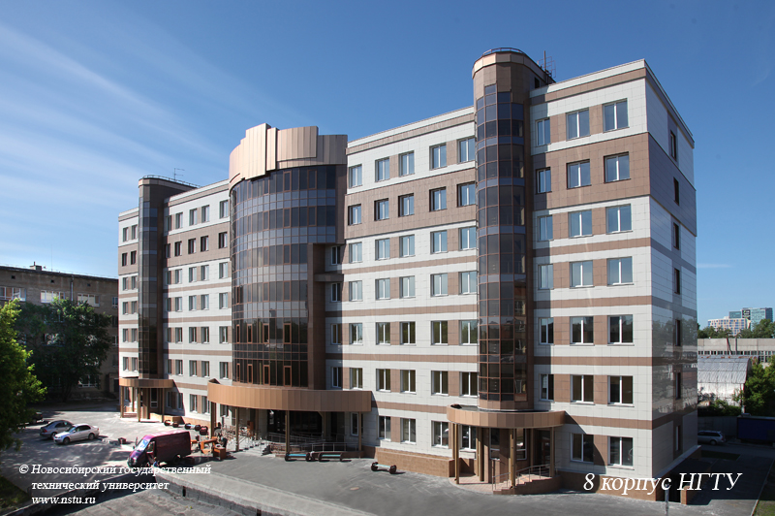
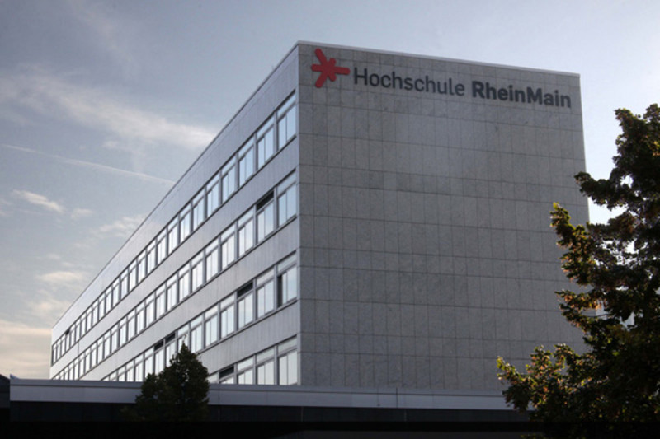
How to prepare an exchange program in Russia/Germany?

Slide 3
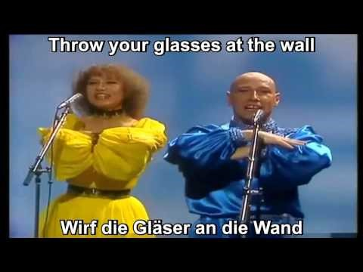
Introduction

Slide 4
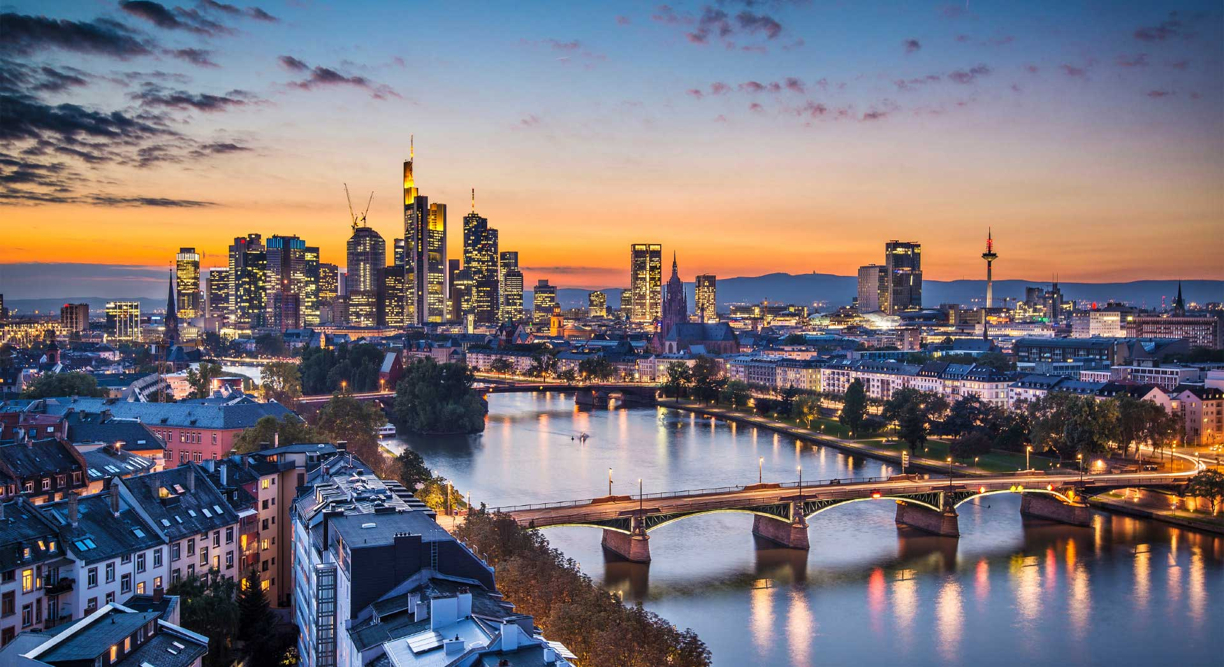

Slide 5
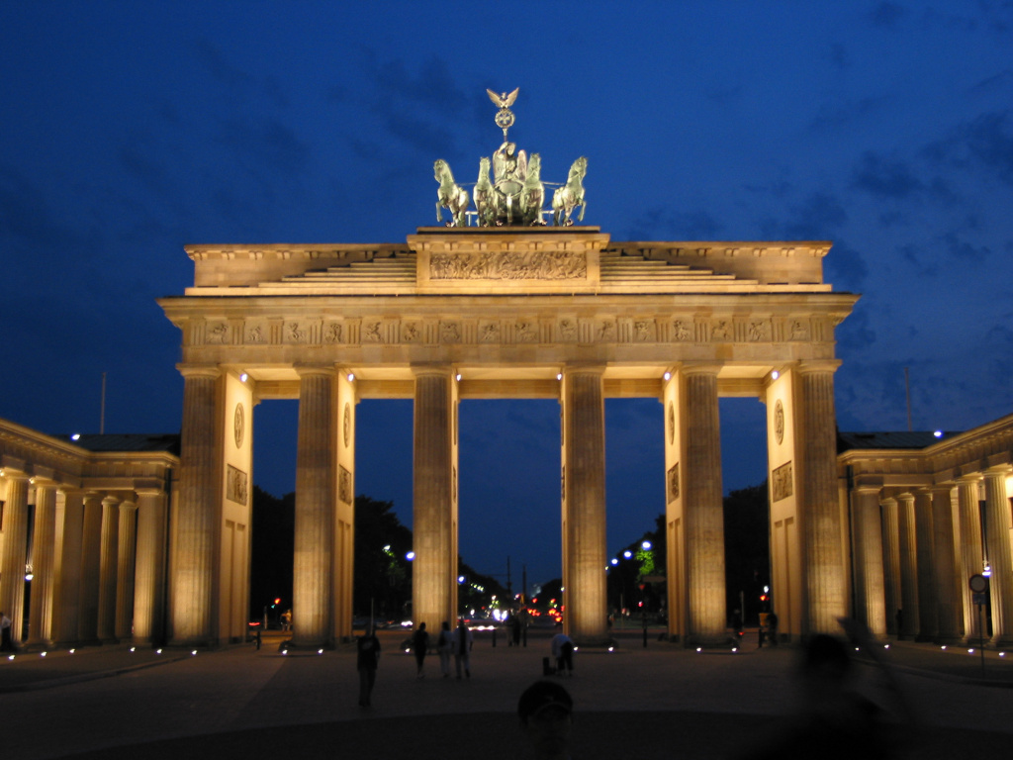

Slide 6
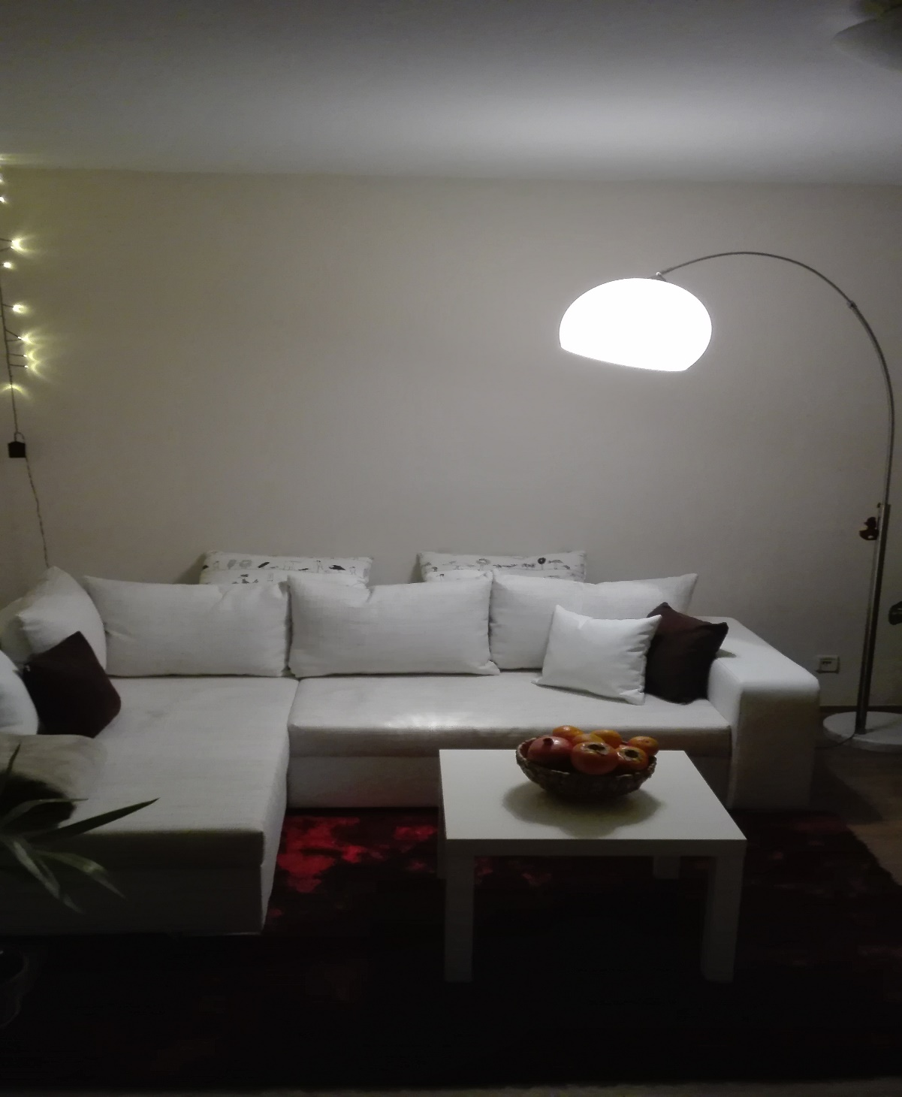
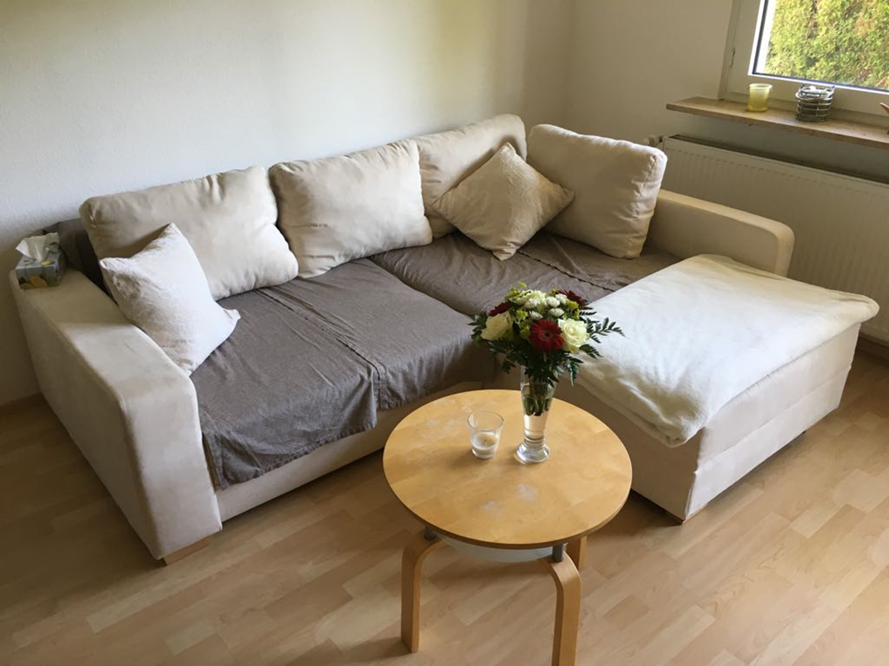

Slide 7
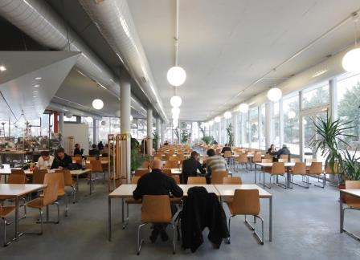

Slide 8
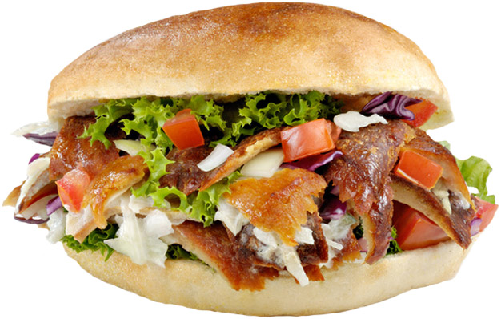

Slide 9
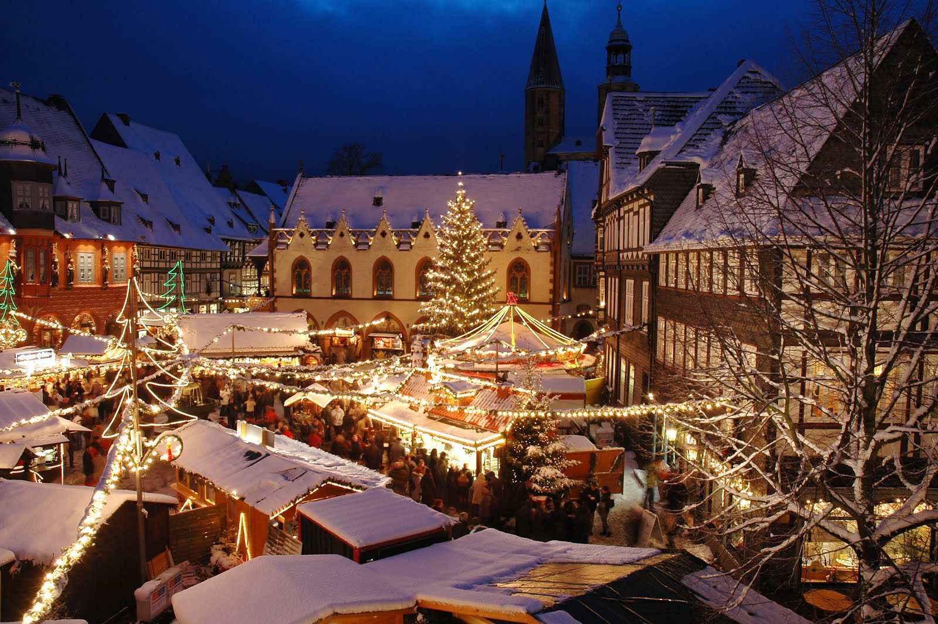

Slide 10
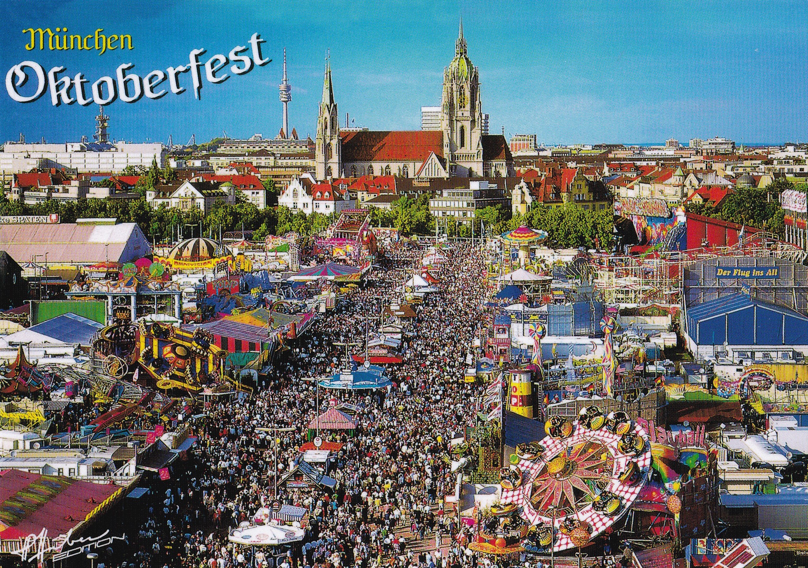

Slide 11

Call me Mister Müller!

Slide 12
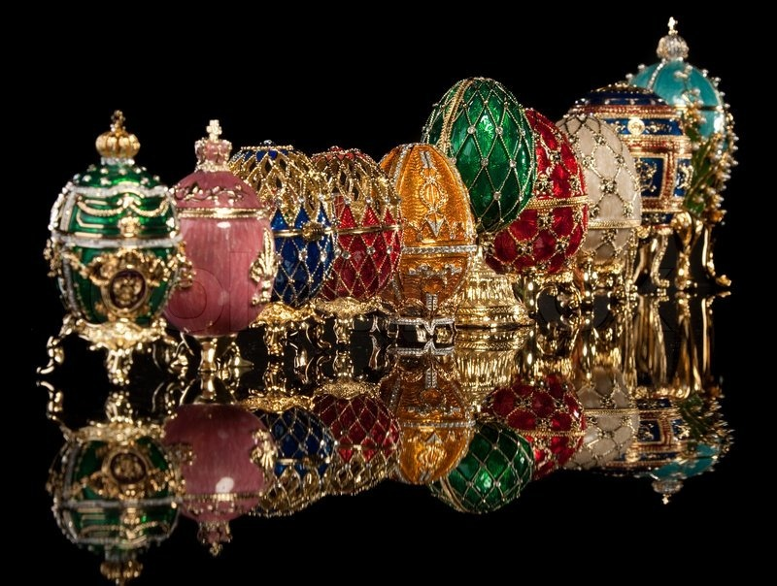

Slide 13
Sources
https://www.youtube.com/watch?v=1lAX1Q8h9A0
https://www.bing.com/images/search?view=detailV2&ccid=fUKscDA1&id=EA2B737C5B1424A4807406D9D96BCFB1653184B2&thid=OIP.fUKscDA1mrv_0dMGupKkzQEsDH&q=nstu+novosibirsk&simid=608048945928866243&selectedIndex=28&ajaxhist=0
https://www.bing.com/images/search?view=detailV2&ccid=Ce4R47Gp&id=636C0146A2C307267B73A1D77095F9B66C90230C&thid=OIP.Ce4R47Gp_Ih0hVsznBak4AEsCj&q=Frankfurt&simid=608007503793948369&selectedIndex=4&ajaxhist=0
https://chrisandlindsey.files.wordpress.com/2011/11/oktoberfest-e1320611343747.jpg
https://www.studentenwerkfrankfurt.de/fileadmin/user_upload/Essen_und_Trinken/Einrichtungen/Hochschule_RheinMain/Mensa_Ruesselsheim/Mensa_Ruesselsheim__1_.jpg
http://www.alibaba-bhv.de/images/ali-baba-bremerhaven-doener.jpg
https://thumbs.dreamstime.com/z/professor-holding-ein-zeiger-stock-36773193.jpg
https://d16tpmyokmwdws.cloudfront.net/blog.php?src=http%3A%2F%2Fblog.barnebys.org%2Fuk%2Fwp-content%2Fuploads%2Fsites%2F3%2F2015%2F04%2F2207579-group-faberge-eggs-isolated-on-black.jpg

Slide 14
Thank you for your attention

