Slide 1
COUNTRY QUIZ
Can you guess which country “is down with” the following cultural events and items?
*to be down with* - used for saying that someone has an illness, also metaphorically

Slide 2
1. Which geographically large country is down with dining on poutine and maple syrup, listening to the music of Seline Dion and partaking in the national sports of ice hockey and lacrosse?
A Canada C China B United States D Russia

Slide 3
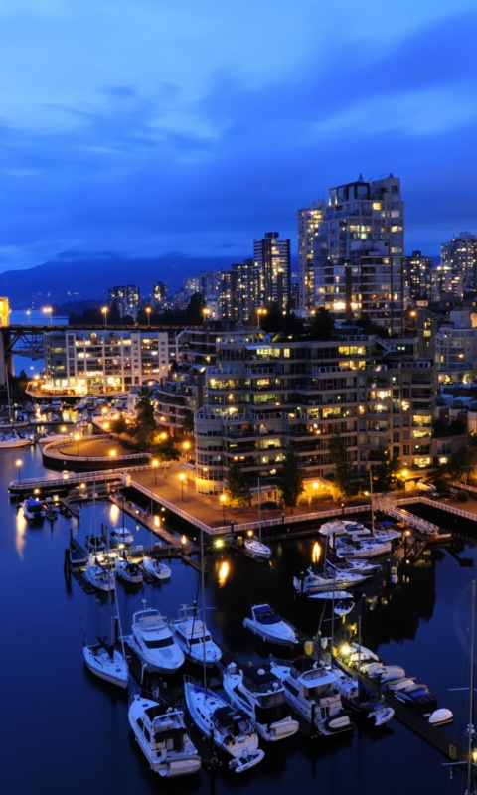
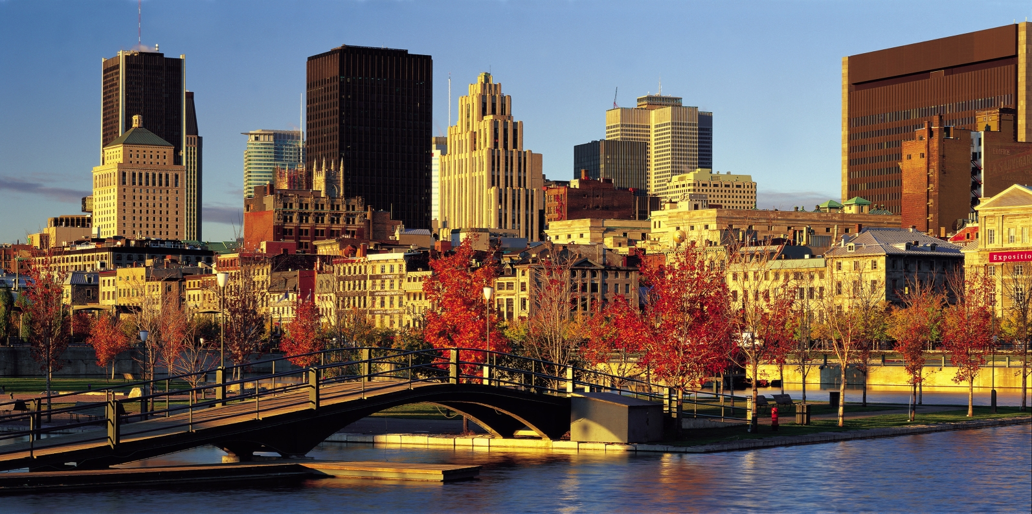
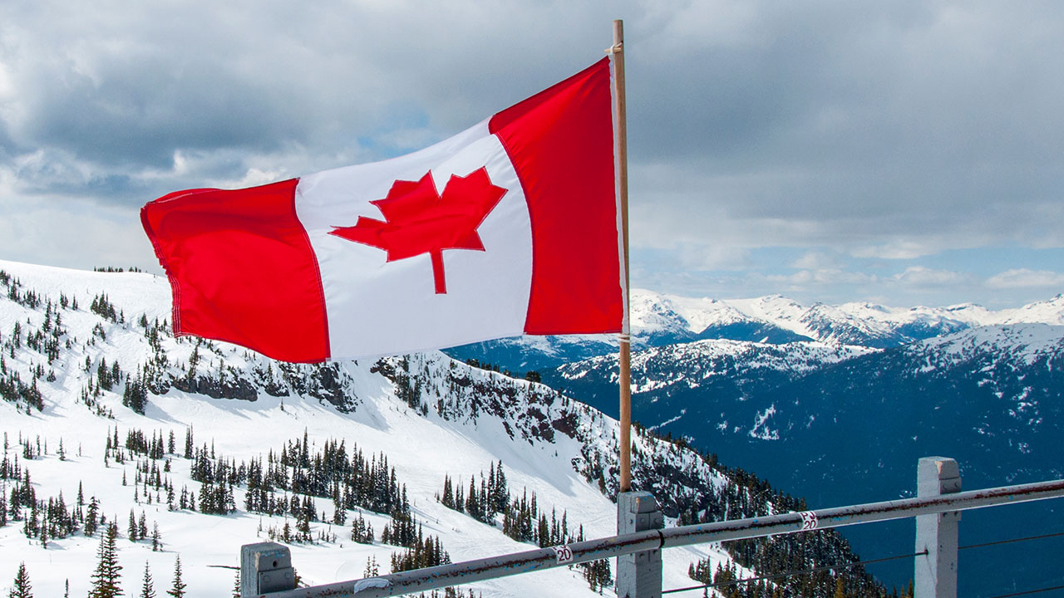
Canada

Slide 4
2. Which of the Mediterranean countries is down with slamming back a few shots of ouzo, eating Feta cheese in Thessaloniki and reading the works of Nobel Prize winning author Odysseas Elytis?
A Italy C Croatia
B Greece D Turkey

Slide 5
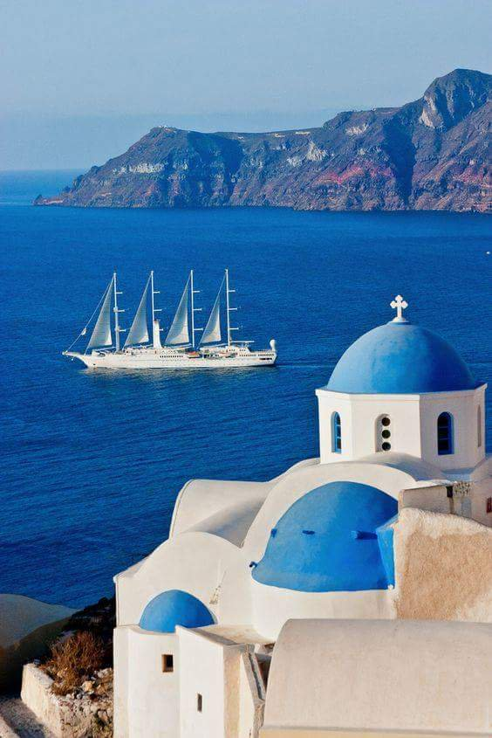
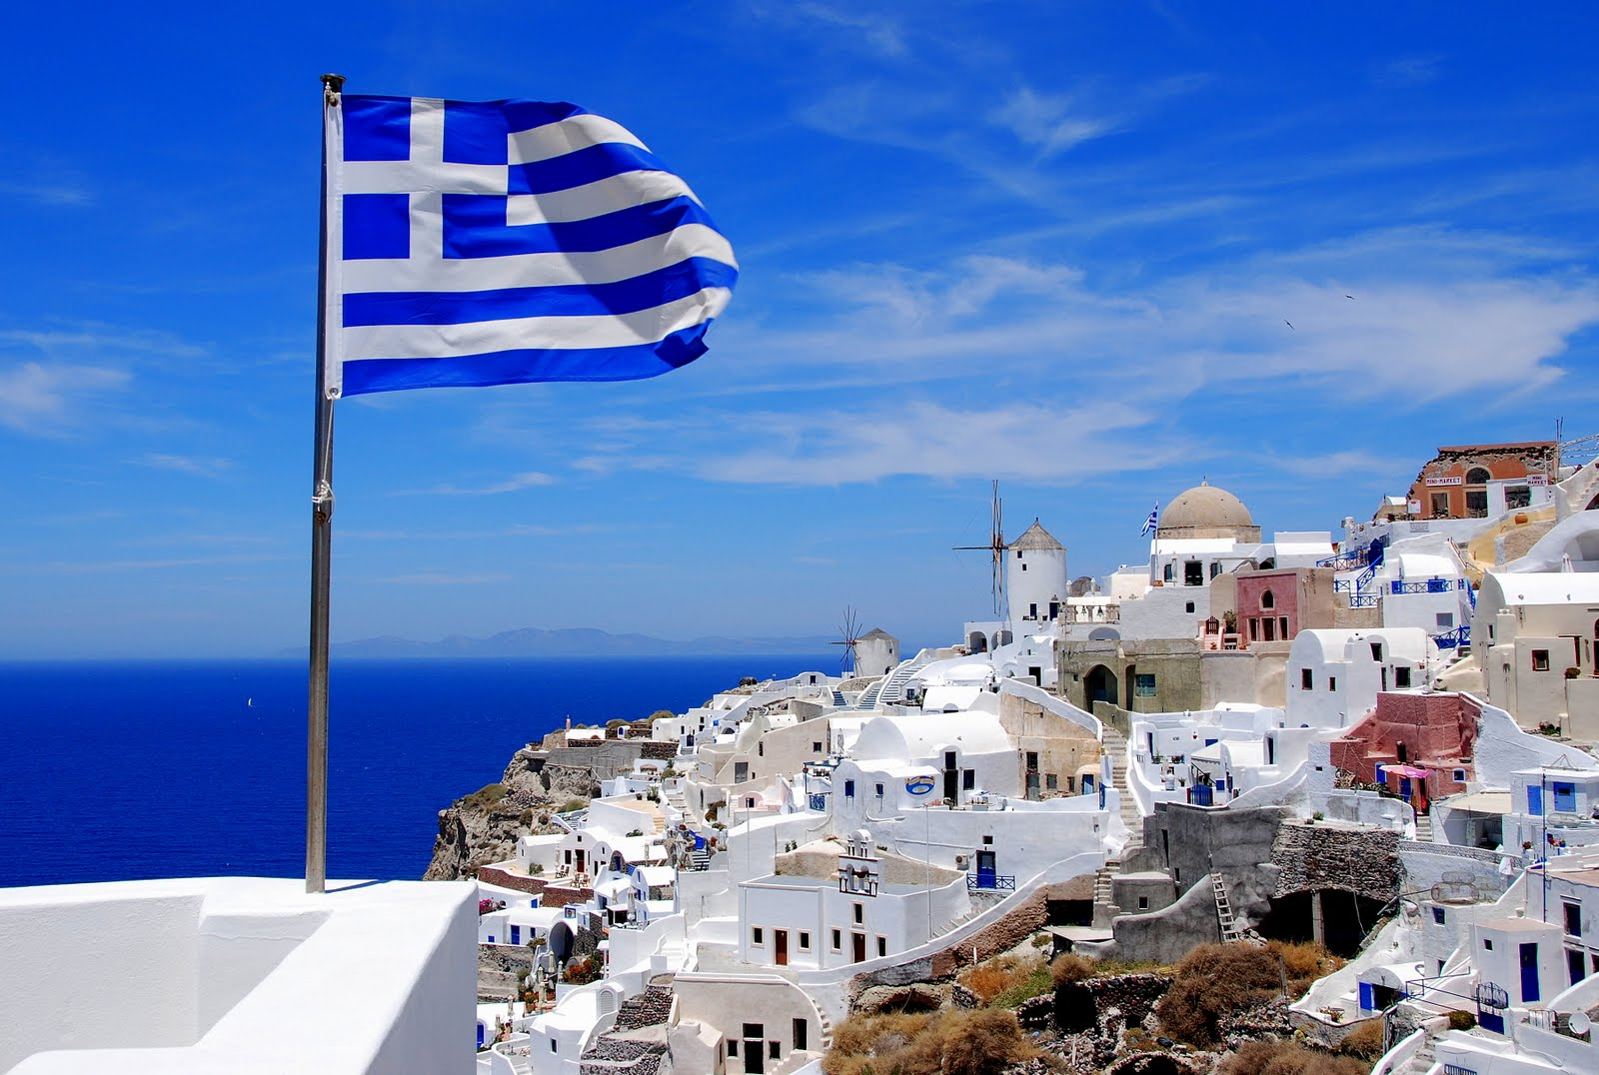
Greece

Slide 6
3. You are a guest at a cocktail party in the British embassy in Washington, D.C. You are conversing with other guests when the server walks by with a tray of a particular drink that he says is very traditional in the U.K. What drink is he most likely to be offering?
A Vodka martini, shaken not stirred
B Gin and tonic C Margarita D Champagne

Slide 7
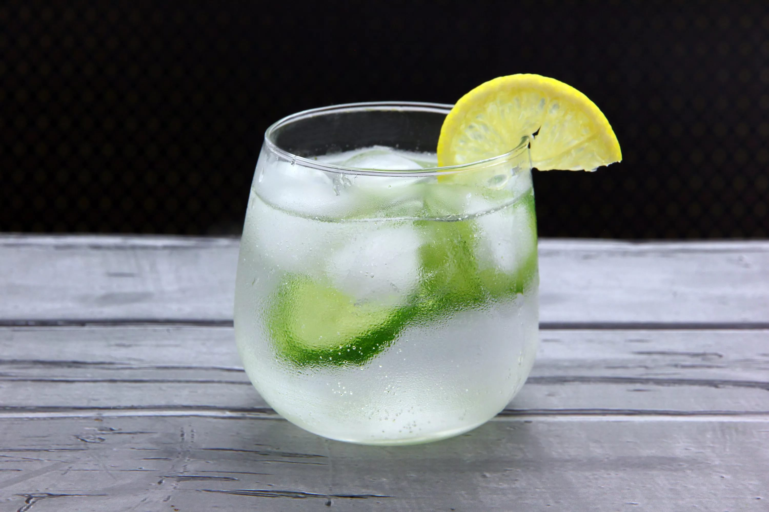
Gin and tonic

Slide 8
4. Which Benelux country is down with dancing in wooden clogs, viewing Van Gogh works at his eponymous museum sampling Edam and Gouda cheeses?
A The Netherlands C France
B Luxembourg D Belgium

Slide 9
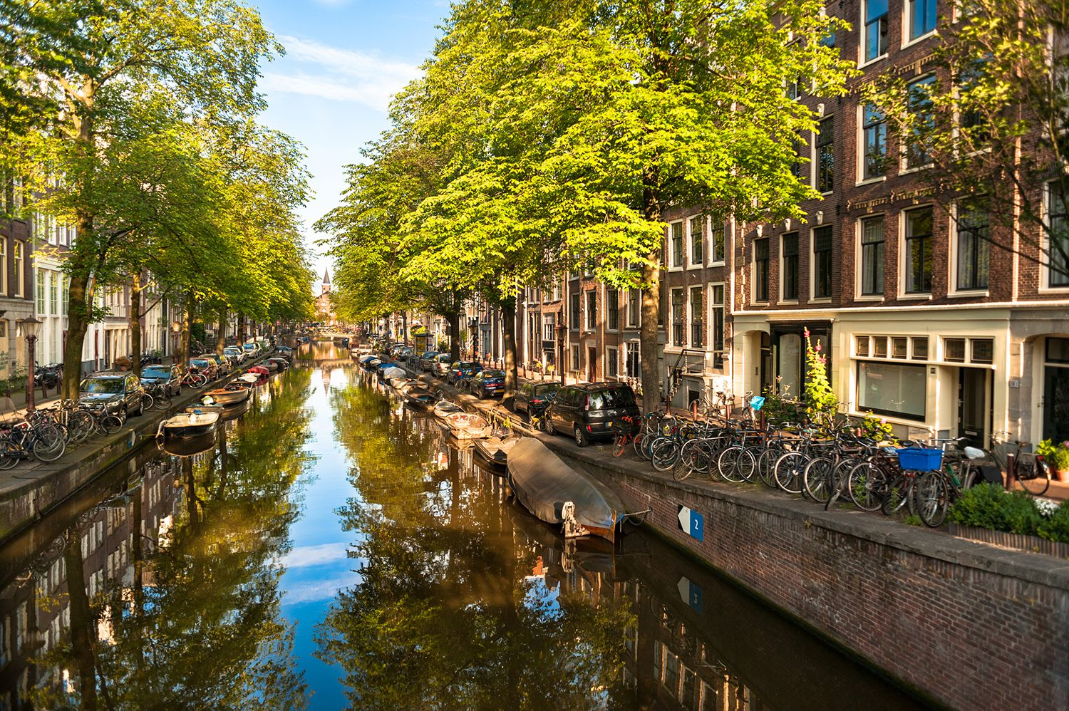
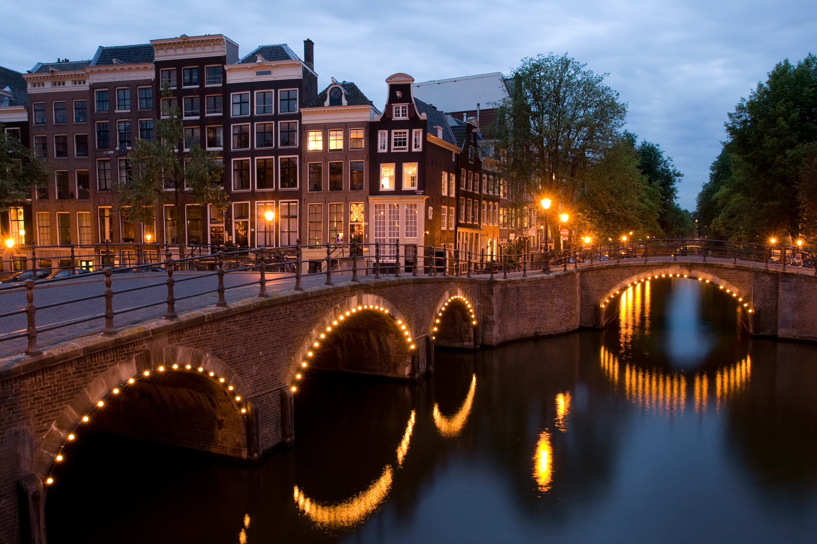
The Netherlands

Slide 10
5. Which South American country is down with partying (especially on carnival, but also all year round), dancing nonstop to Samba music and spending hours upon hours watching soccer in the Maracana stadium?
A Brazil C Colombia? B Peru D Argentina

Slide 11
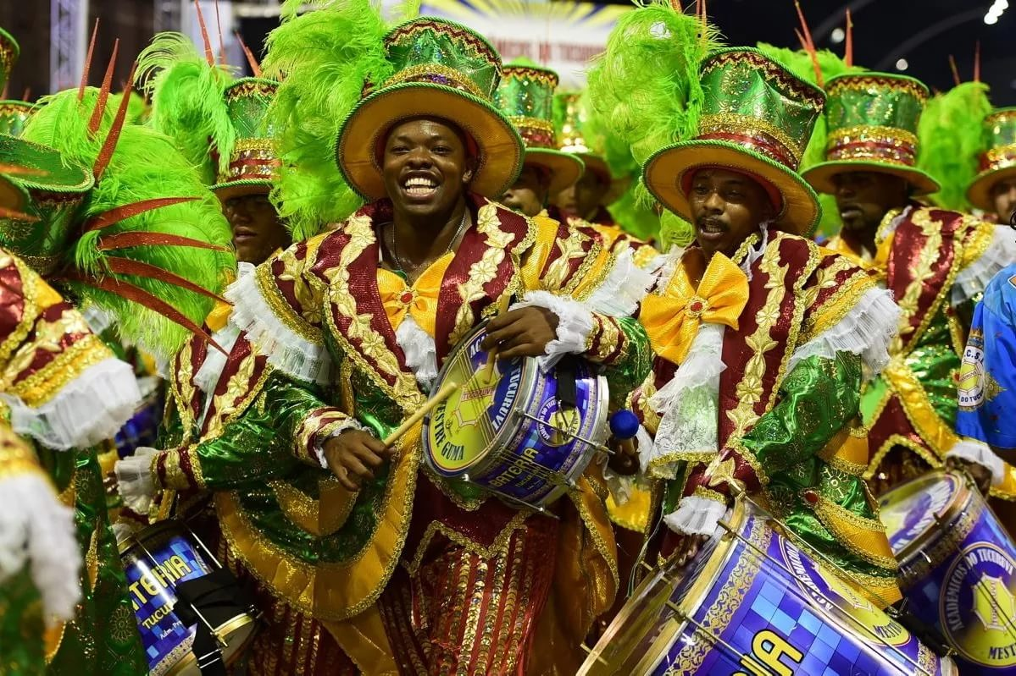
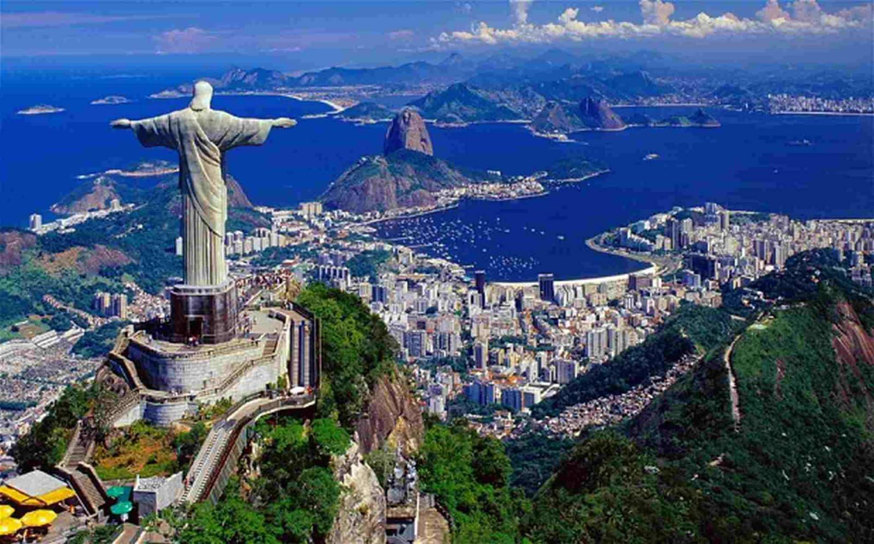
Brazil

Slide 12
6. You bump into a group of Australian students in a bar in Sydney. You all have a lot in common, so they invite you back to their place for "snags" on the barbie. You know they mean a barbecue, but what type of food are they most likely to be cooking?
A Shrimps B Salmon
C Steaks D Sausages

Slide 13
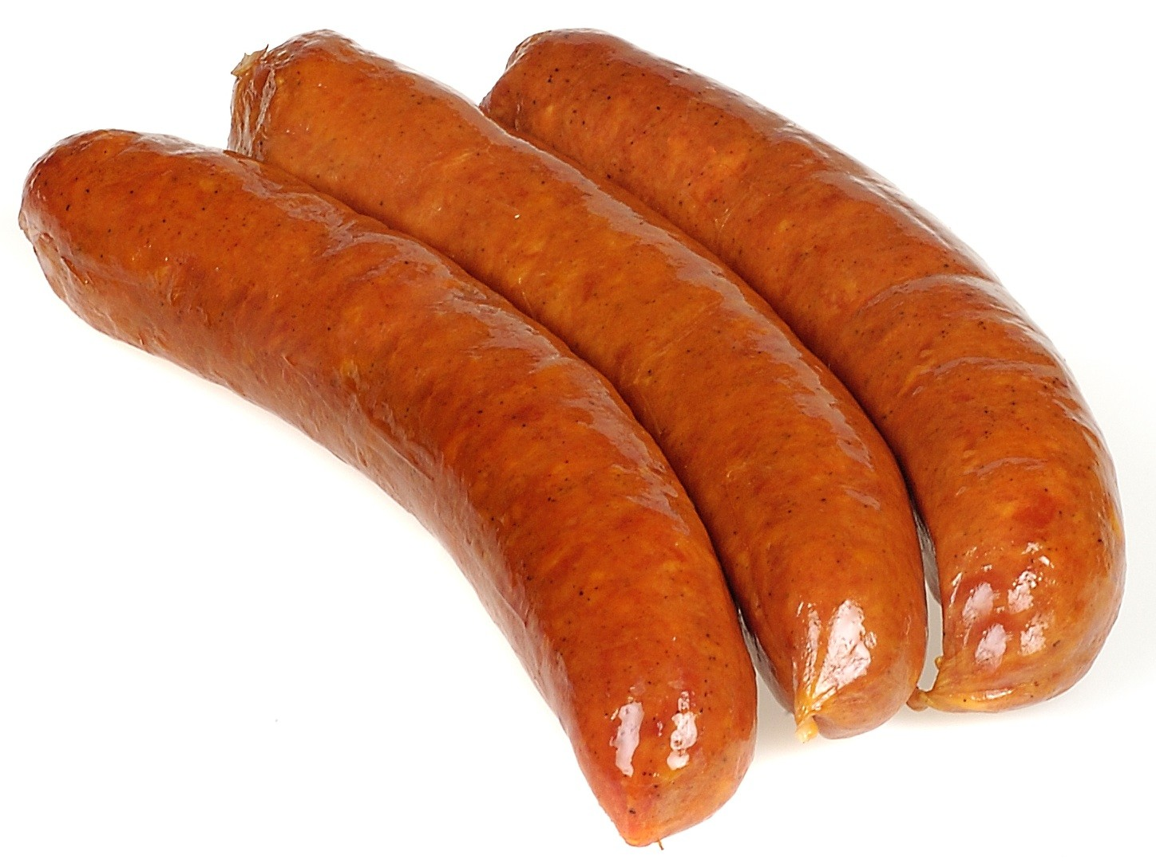
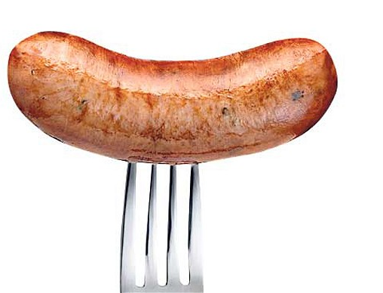
Sausages

Slide 14
7. What is the "proper" way to eat peas in England?
A With a spoon
B Stabbed with a butter knife
C Pierced with the tines of the fork
D Mashed with a fork

Slide 15
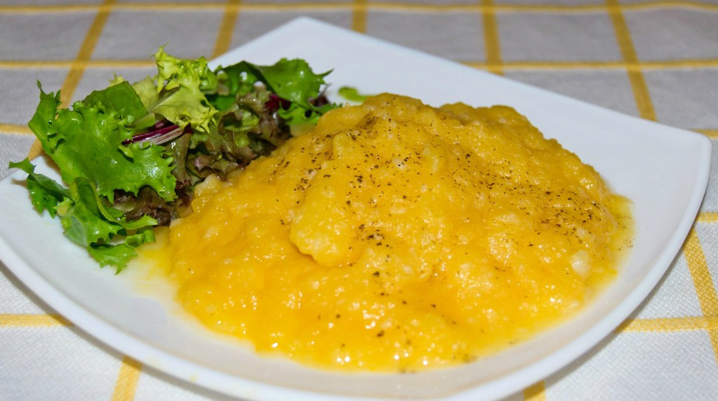
Mashed with a fork

Slide 16
8. Which populous country is down with throwing colors on Holi, binge watching Aishwarya Rai movies and celebrating over ten million weddings a year?
A China C India B Indonesia D Japan

Slide 17
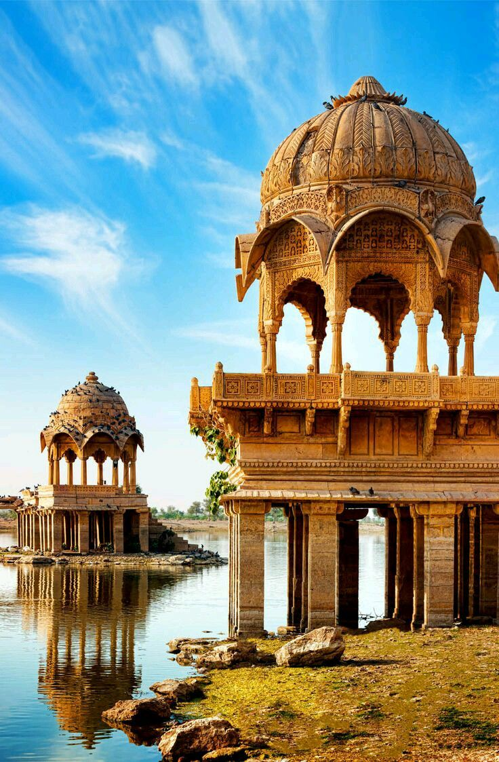
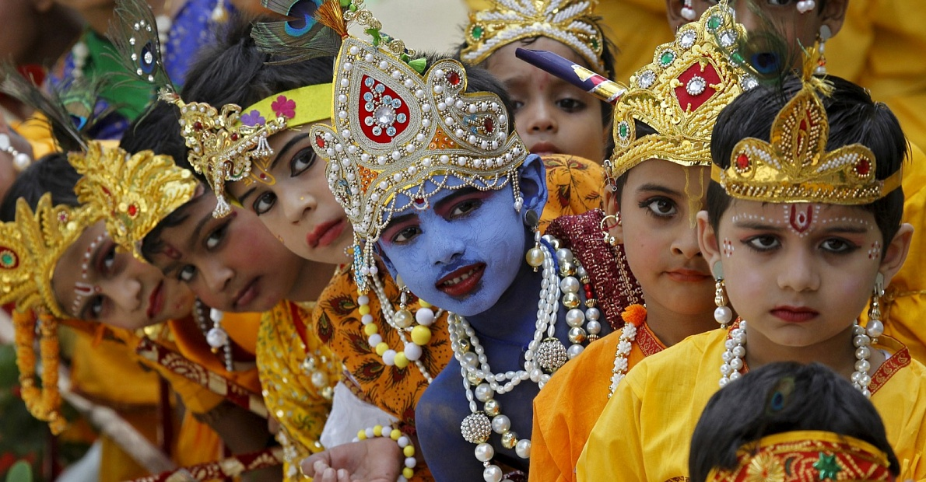
India

Slide 18
9. Which northwest European country, bordering the North sea is down with waffles and chocolates?
A France B Luxembourg
C Germany D Belgium

Slide 19
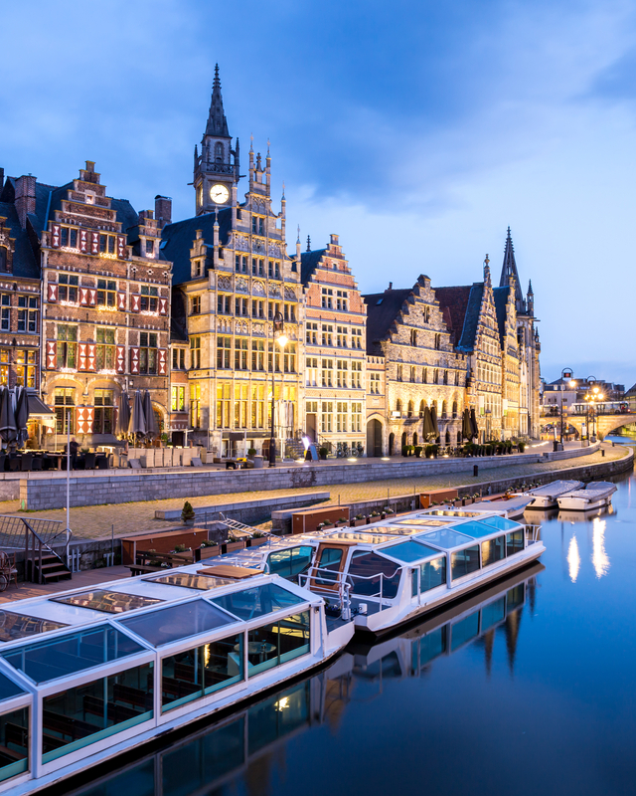
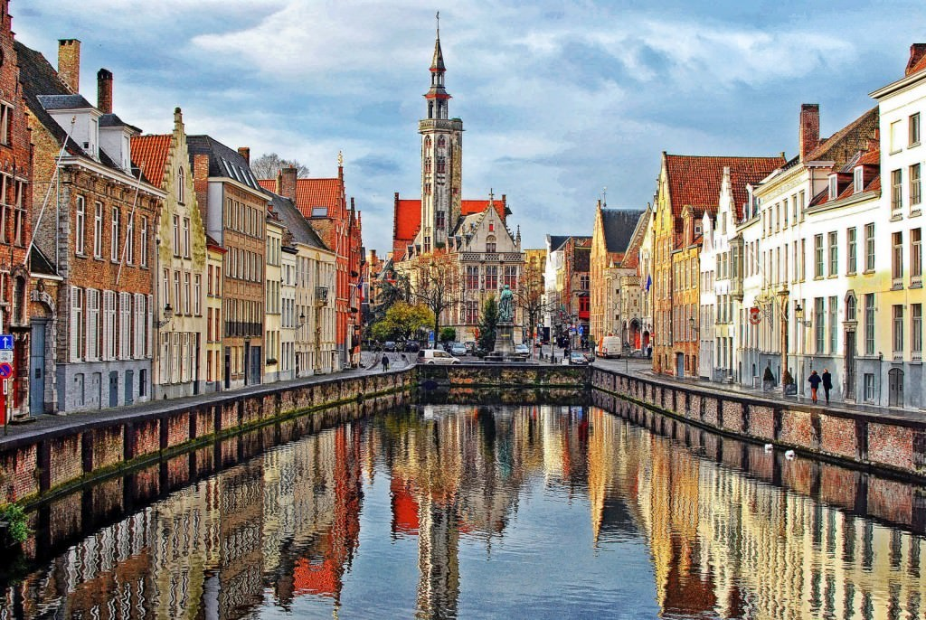
Belgium

Slide 20
10. Which Southeast Asian country is down with cooking up some Fho, practicing the martial art of Nhat-nam and listening to some Ca Tru music?
A Thailand C Cambodia B Laos D Vietnam

Slide 21
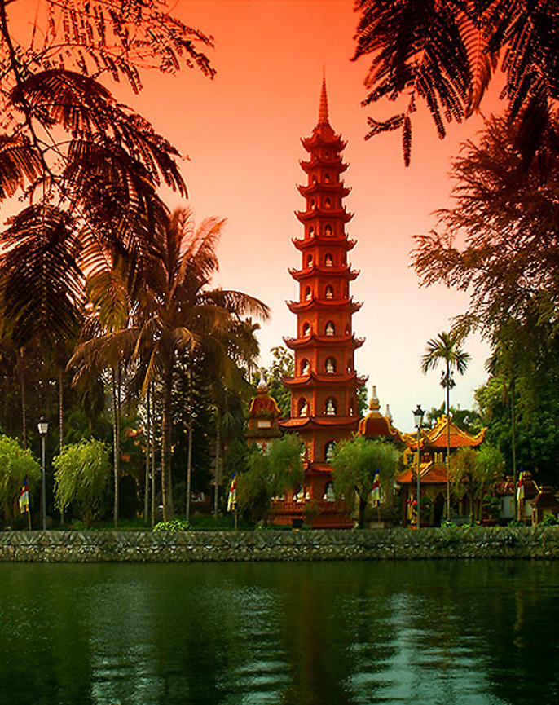
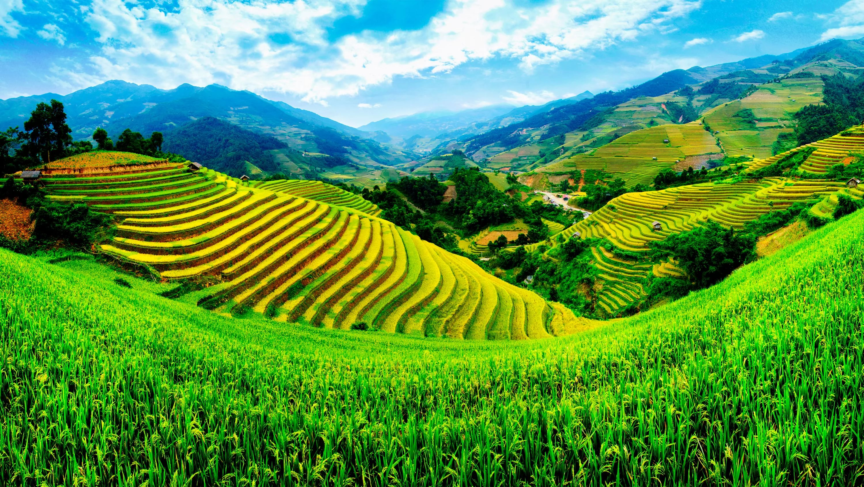
Vietnam

Slide 22
11. Which African nation is down with going on Safari, beating the drum to Benga music and weaving brightly colored clothes out of Kitenge fabric?
A South Africa C Kenya B Nigeria D Egypt

Slide 23
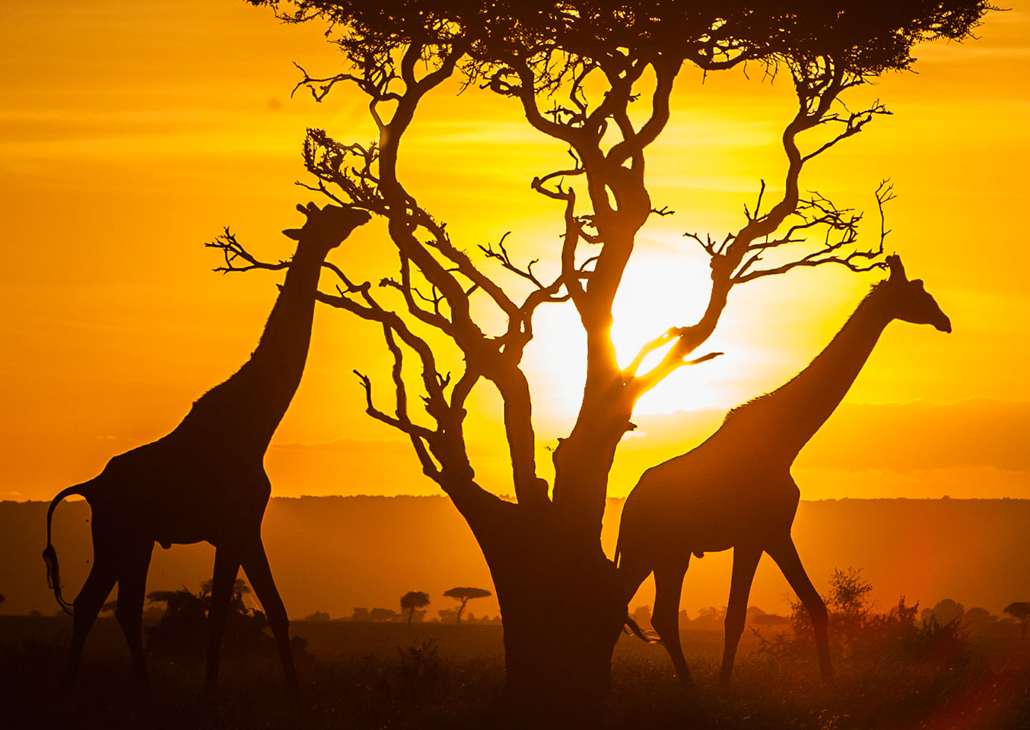
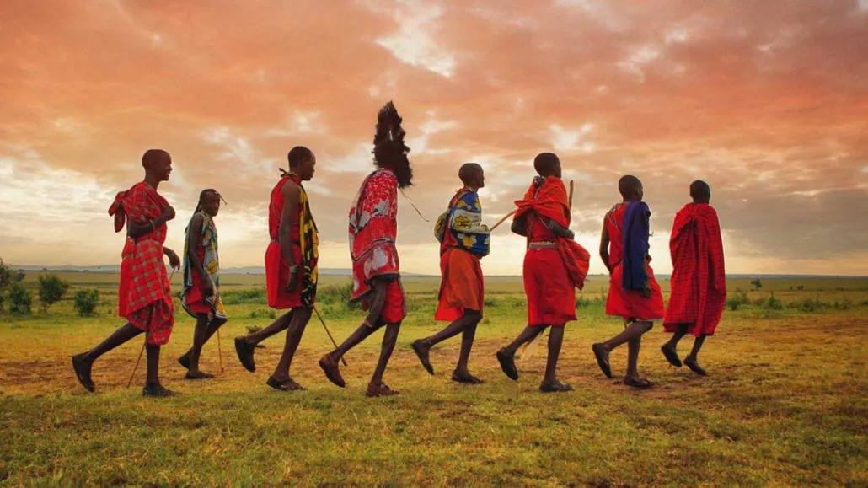
Kenya

Slide 24
12.In which country the largest population of kiwis can be found?
A Italy C China
B New Zealand D Iran

Slide 25
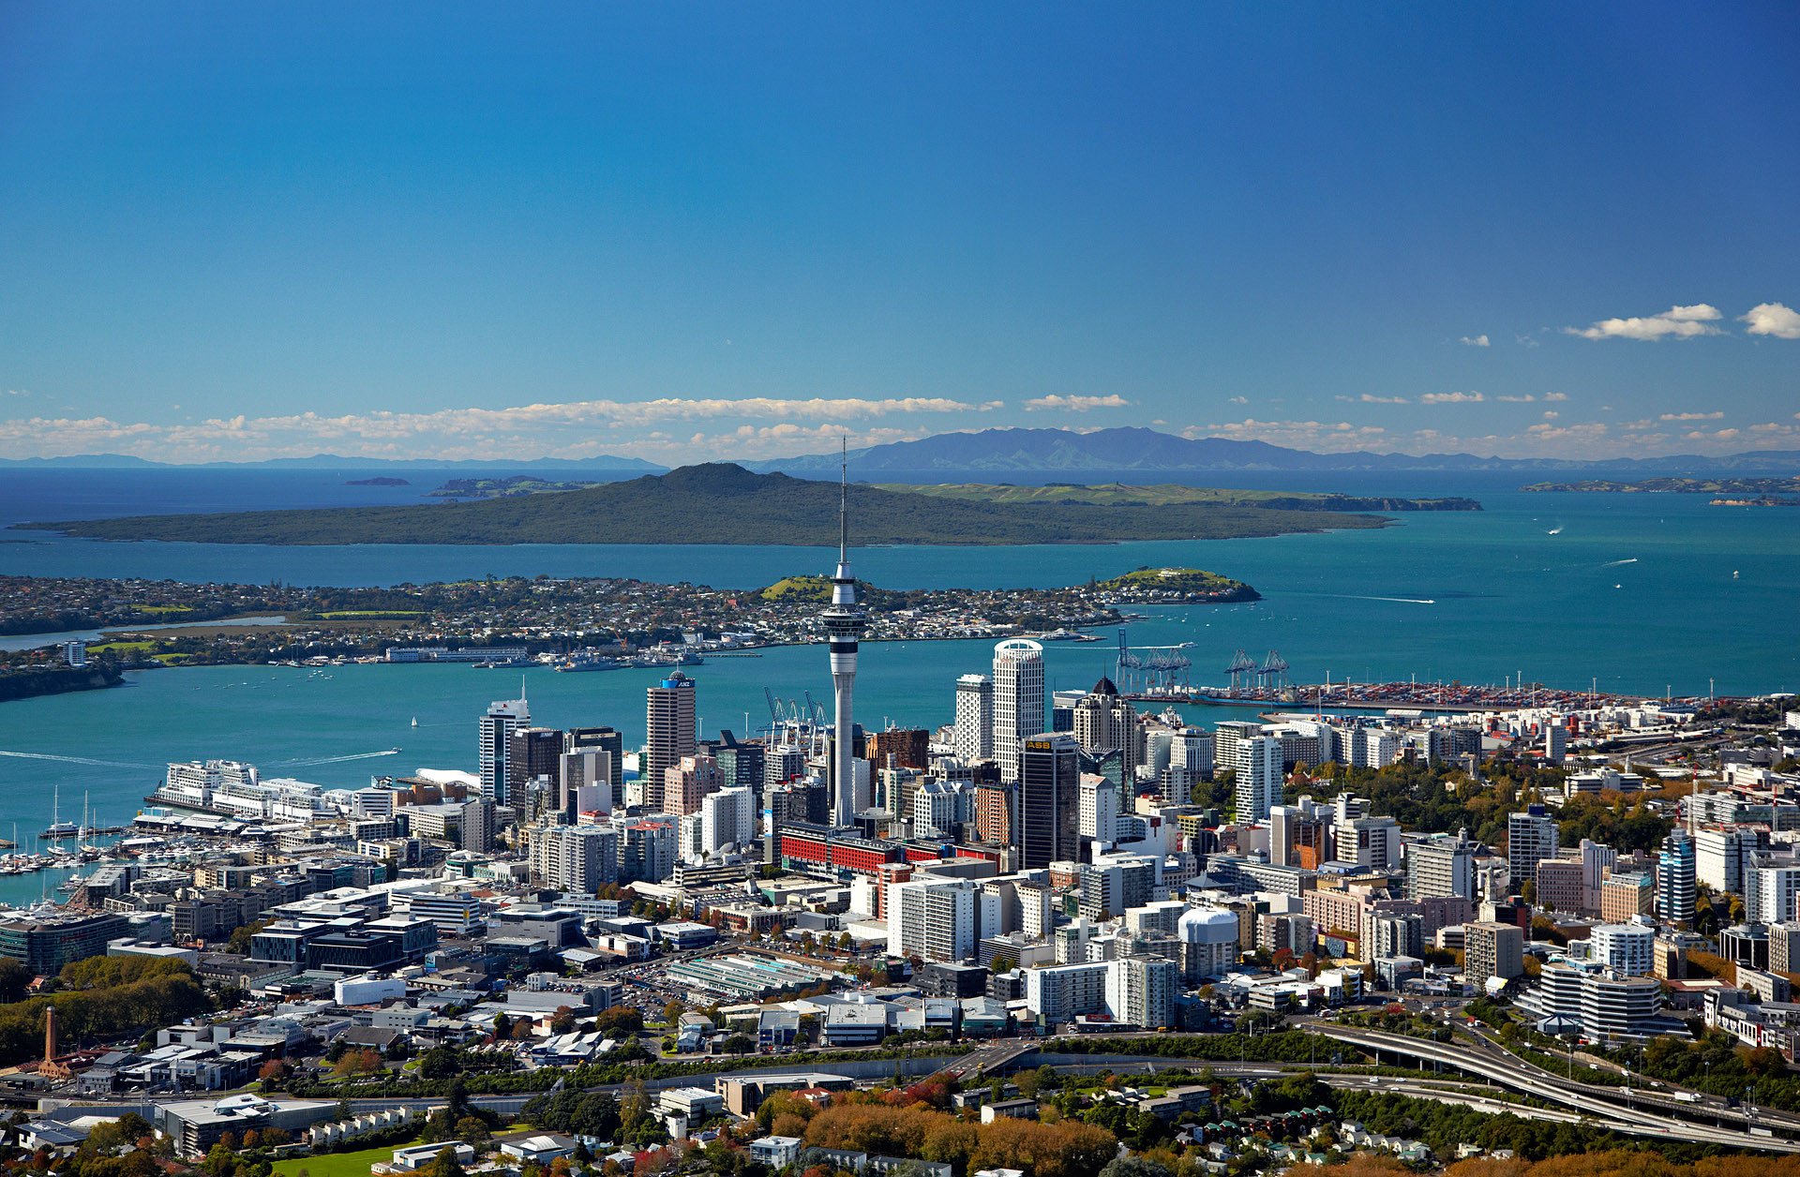
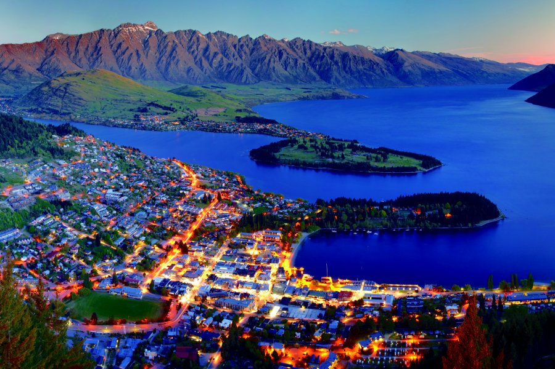
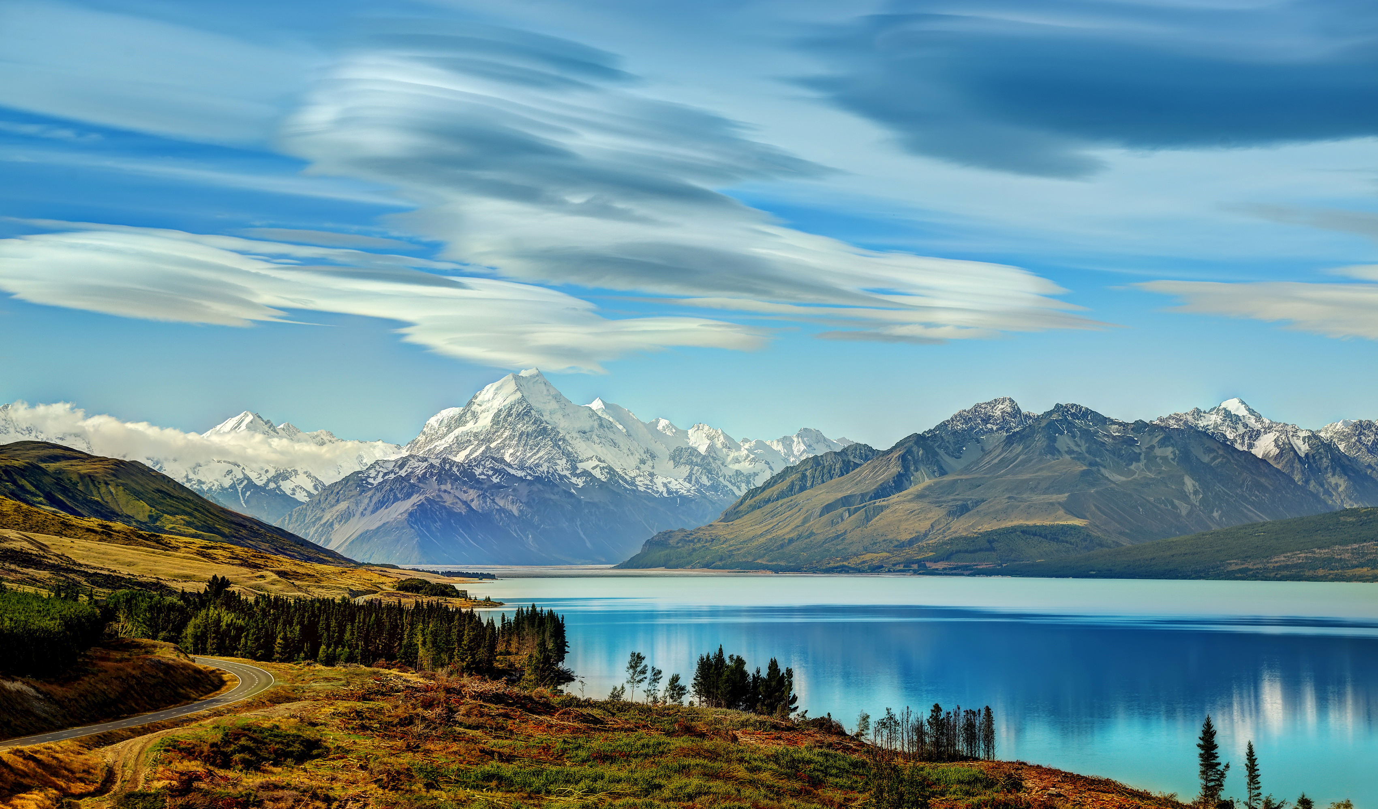
New Zealand

Slide 26
13.In which country people can communicate in 37 official languages?
A Bolivia C Cambodia
B Argentina D Nepal

Slide 27
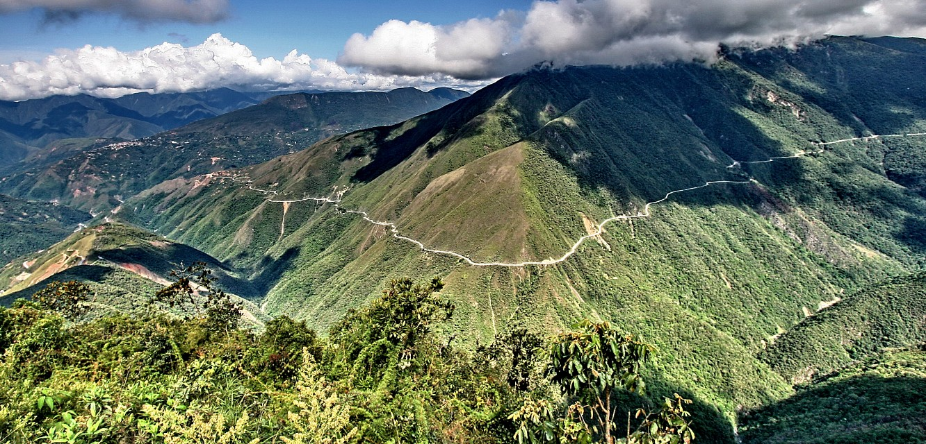
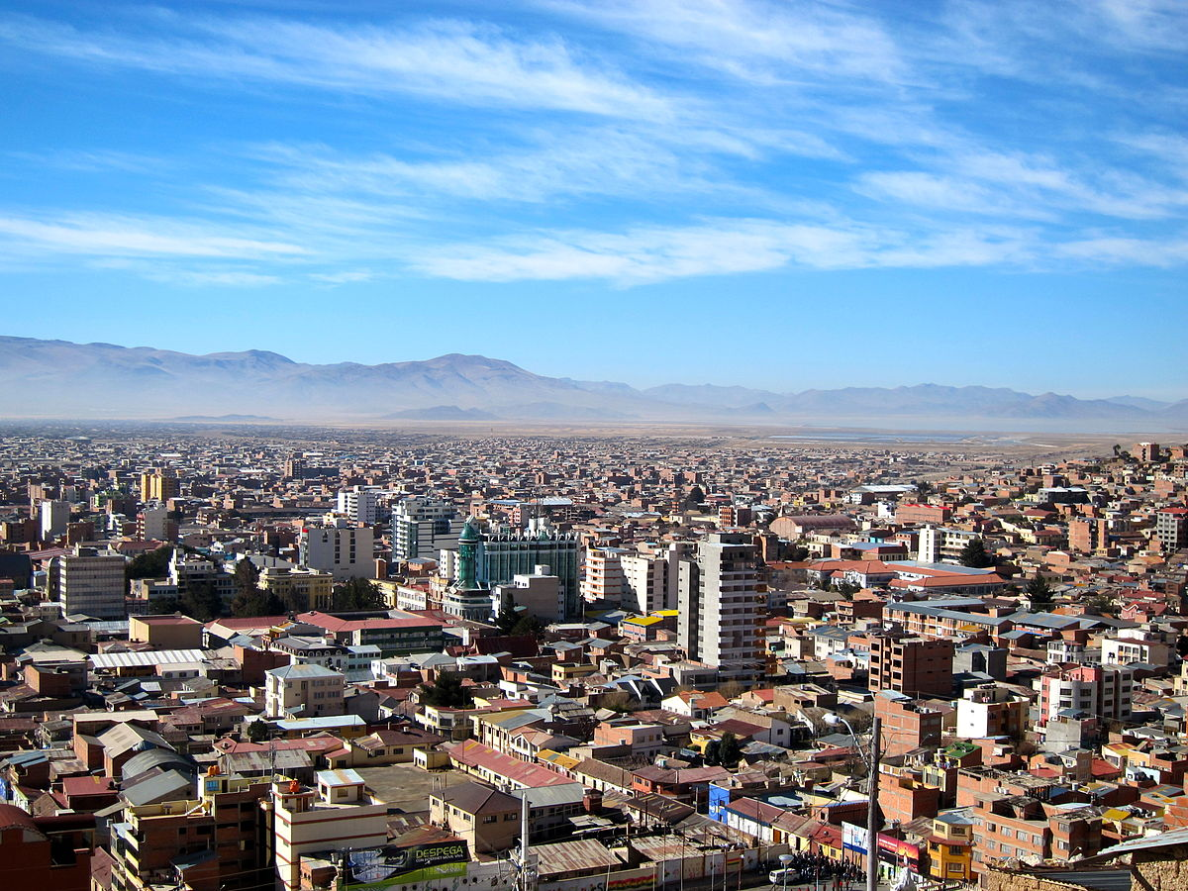
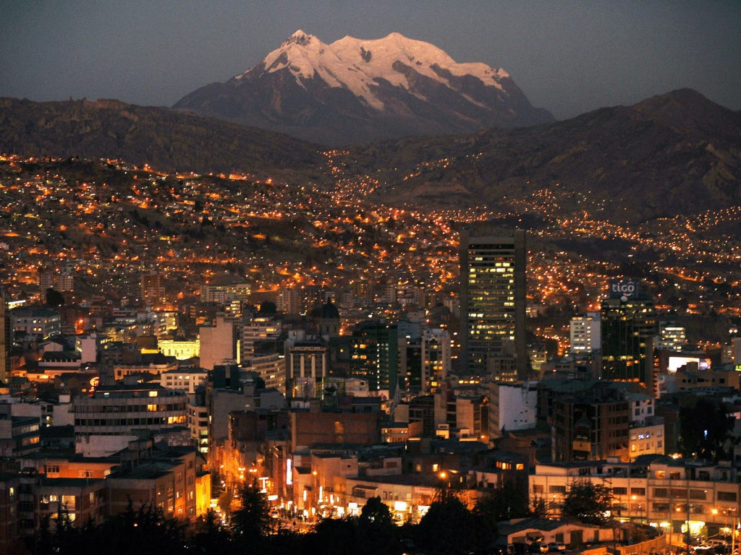
Bolivia

Slide 28
14. The inhabitants of which country have to cross two other countries if they want to drive to the sea?
A Czech Republic C Belarus
B Austria D Liechtenstein

Slide 29
D Liechtenstein

